Slide 1
Ohio Traffic Safety office
FFY 2014 High Visibility Enforcement Overtime Grant Pre-Activity Presentation

Slide 2
Who Should View?
The Project Director is required to view the Pre-Activity Presentation and complete the Pre-Activity form.
The Fiscal Officer is encouraged to view the presentation.

Slide 3
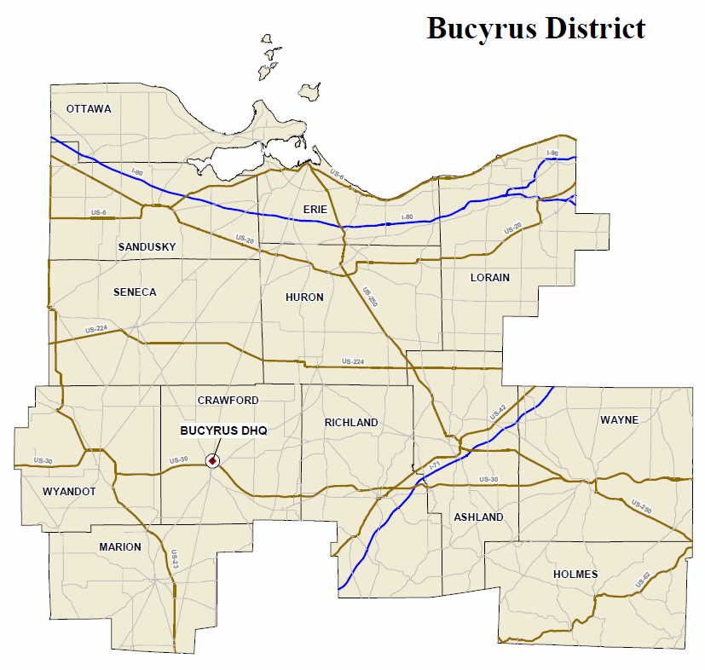
Contact Information – Bucyrus District
County | OTSO Contact | LEL | OSP Patrol Post
Ashland | Kelvin Williams | Frank Arvay | Ashland
Crawford | Kelvin Williams | Frank Arvay | Bucyrus
Erie | Kelvin Williams | Frank Arvay | Sandusky
Holmes | Kelvin Williams | Frank Arvay | Wooster
Huron | Kelvin Williams | Frank Arvay | Norwalk
Lorain | Kelvin Williams | Frank Arvay | Elyria
Marion | Kelvin Williams | Frank Arvay | Marion
Ottawa | Kelvin Williams | Frank Arvay | Sandusky
Richland | Kelvin Williams | Frank Arvay | Mansfield
Sandusky | Kelvin Williams | Frank Arvay | Fremont
Seneca | Kelvin Williams | Frank Arvay | Fremont
Wayne | Kelvin Williams | Frank Arvay | Wooster
Wyandot | Kelvin Williams | Frank Arvay | Bucyrus
Contact Information:
OTSO: 614/466-3250
Frank Arvay: 419/213-0084
OSP Patrol Post: http://statepatrol.ohio.gov/Counties.stm

Slide 4
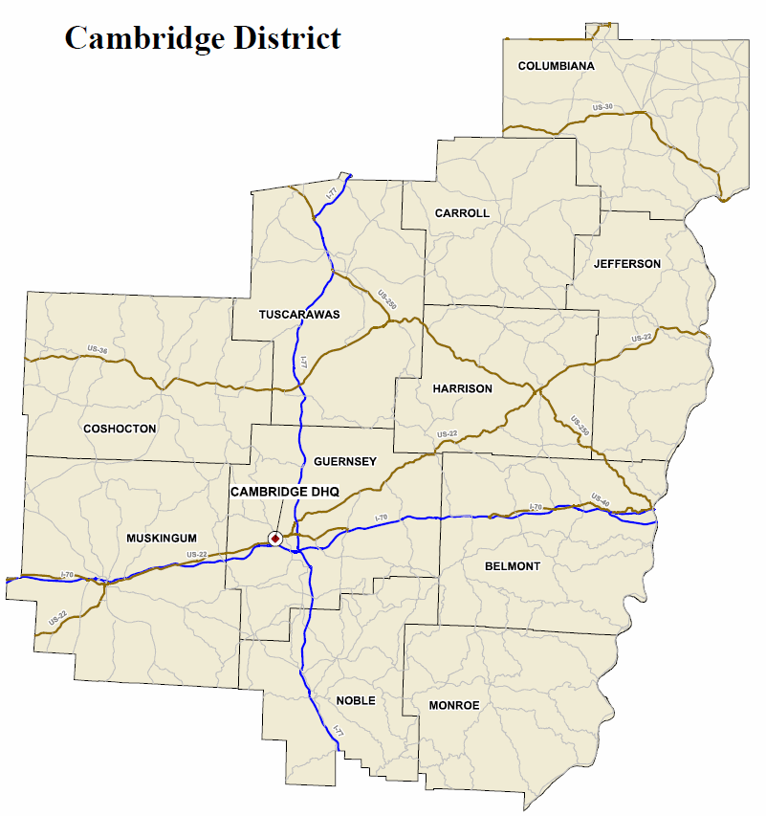
Contact Information – Cambridge District
Contact Information:
OTSO: 614/466-3250
Rick Beverley: 330/697-1714
OSP Patrol Post: http://statepatrol.ohio.gov/Counties.stm
County | OTSO Contact | LEL | OSP Patrol Post
Belmont | Jackie Stephenson | Rick Beverley | St. Clairsville
Carroll | Jackie Stephenson | Rick Beverley | New Philadelphia
Columbiana | Jackie Stephenson | Rick Beverley | Lisbon
Coshocton | Jackie Stephenson | Rick Beverley | Zanesville
Guernsey | Jackie Stephenson | Rick Beverley | Cambridge
Harrison | Jackie Stephenson | Rick Beverley | Steubenville
Jefferson | Jackie Stephenson | Rick Beverley | Steubenville
Monroe | Jackie Stephenson | Rick Beverley | St. Clairsville
Muskingum | Jackie Stephenson | Rick Beverley | Zanesville
Noble | Jackie Stephenson | Rick Beverley | Cambridge
Tuscarawas | Jackie Stephenson | Rick Beverley | New Philadelphia

Slide 5
Contact Information – Columbus District
County | OTSO Contact | LEL | OSP Patrol Post
Delaware | Jackie Stephenson | Mike Brining | Delaware
Fairfield | Jackie Stephenson | Mike Brining | Lancaster
Franklin | Jackie Stephenson | Mike Brining | Columbus
Knox | Jackie Stephenson | Mike Brining | Mt. Gilead
Licking | Jackie Stephenson | Mike Brining | Granville
Madison | Jackie Stephenson | Mike Brining | West Jefferson
Morrow | Jackie Stephenson | Mike Brining | Mt. Gilead
Perry | Jackie Stephenson | Mike Brining | Lancaster
Pickaway | Jackie Stephenson | Mike Brining | Circleville
Contact Information:
OTSO: 614/466-3250
Mike Brining: 614/946-2878
OSP Patrol Post: http://statepatrol.ohio.gov/Counties.stm

Slide 6
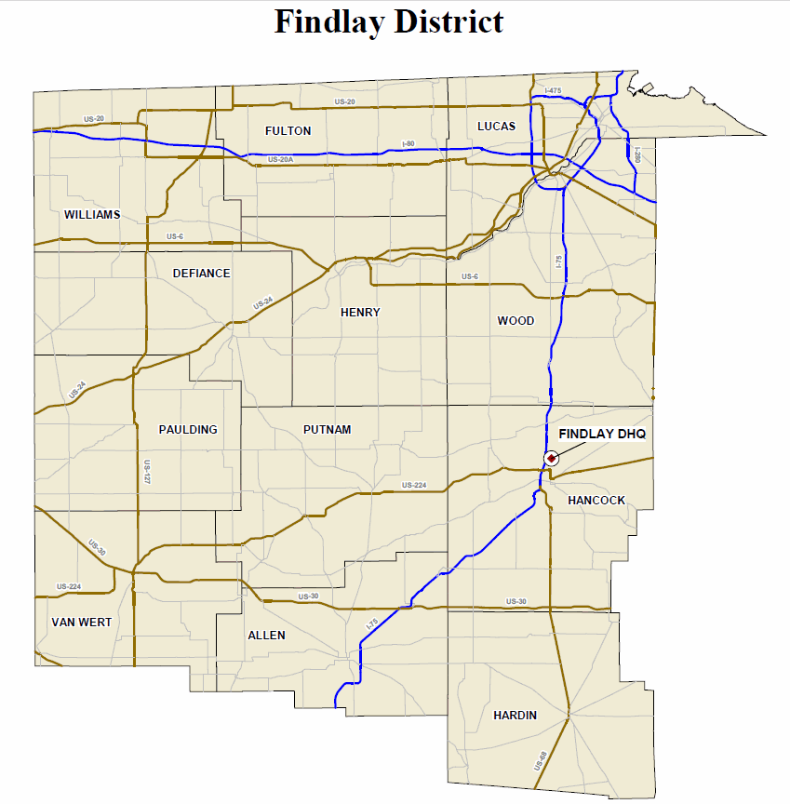
Contact Information – Findlay District
County | OTSO Contact | LEL | OSP Patrol Post
Allen | Kelvin Williams | Frank Arvay | Lima
Defiance | Kelvin Williams | Frank Arvay | Defiance
Fulton | Kelvin Williams | Frank Arvay | Toledo
Hancock | Kelvin Williams | Frank Arvay | Findlay
Hardin | Kelvin Williams | Frank Arvay | Findlay
Henry | Kelvin Williams | Frank Arvay | Bowling Green
Lucas | Kelvin Williams | Frank Arvay | Toledo
Paulding | Kelvin Williams | Frank Arvay | Van Wert
Putnam | Kelvin Williams | Frank Arvay | Lima
Van Wert | Kelvin Williams | Frank Arvay | Van Wert
Williams | Kelvin Williams | Frank Arvay | Defiance
Wood | Kelvin Williams | Frank Arvay | Bowling Green
Contact Information:
OTSO: 614/466-3250
Frank Arvay: 419/213-0084
OSP Patrol Post: http://statepatrol.ohio.gov/Counties.stm

Slide 7
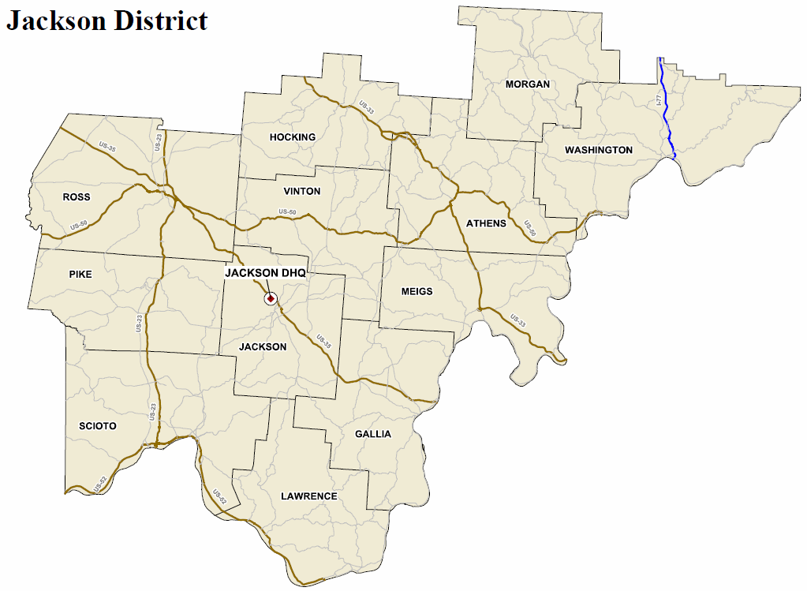
Contact Information – Jackson District
Contact Information:
OTSO: 614/466-3250
Mike Brining: 614/946-2878
OSP Patrol Post: http://statepatrol.ohio.gov/Counties.stm
County | OTSO Contact | LEL | OSP Patrol Post
Athens | Jackie Stephenson | Mike Brining | Athens
Gallia | Jackie Stephenson | Mike Brining | Gallipolis
Hocking | Jackie Stephenson | Mike Brining | Athens
Jackson | Jackie Stephenson | Mike Brining | Jackson
Lawrence | Jackie Stephenson | Mike Brining | Ironton
Meigs | Jackie Stephenson | Mike Brining | Gallipolis
Morgan | Jackie Stephenson | Mike Brining | Marietta
Pike | Jackie Stephenson | Mike Brining | Chillicothe
Ross | Jackie Stephenson | Mike Brining | Chillicothe
Scioto | Jackie Stephenson | Mike Brining | Portsmouth
Vinton | Jackie Stephenson | Mike Brining | Jackson
Washington | Jackie Stephenson | Mike Brining | Marietta

Slide 8
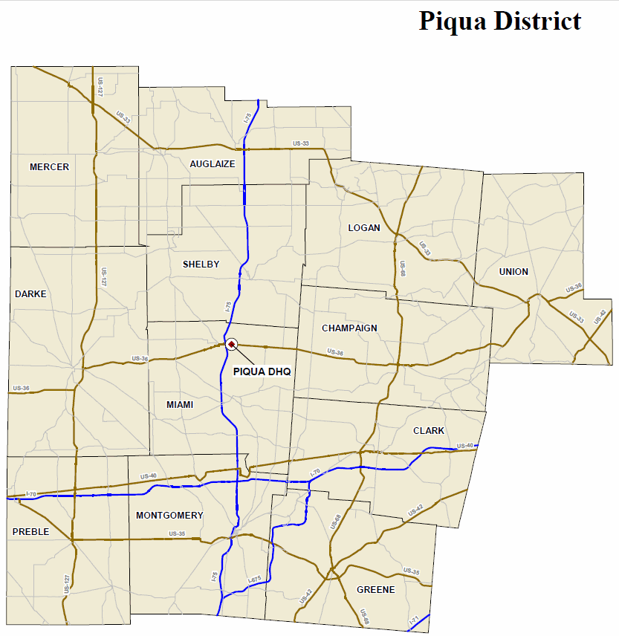
Contact Information – Piqua District
Contact Information:
OTSO: 614/466-3250
Chris Robertson: 513/518-8548
OSP Patrol Post: http://statepatrol.ohio.gov/Counties.stm
County | OTSO Contact | LEL | OSP Patrol Post
Auglaize | Kelvin Williams | Chris Robertson | Wapakoneta
Champaign | Kelvin Williams | Chris Robertson | Springfield
Clark | Kelvin Williams | Chris Robertson | Springfield
Darke | Kelvin Williams | Chris Robertson | Dayton
Greene | Kelvin Williams | Chris Robertson | Xenia
Logan | Kelvin Williams | Chris Robertson | Marysville
Mercer | Kelvin Williams | Chris Robertson | Wapakoneta
Miami | Kelvin Williams | Chris Robertson | Piqua
Montgomery | Kelvin Williams | Chris Robertson | Dayton
Preble | Kelvin Williams | Chris Robertson | Dayton
Shelby | Kelvin Williams | Chris Robertson | Piqua
Union | Kelvin Williams | Chris Robertson | Marysville

Slide 9
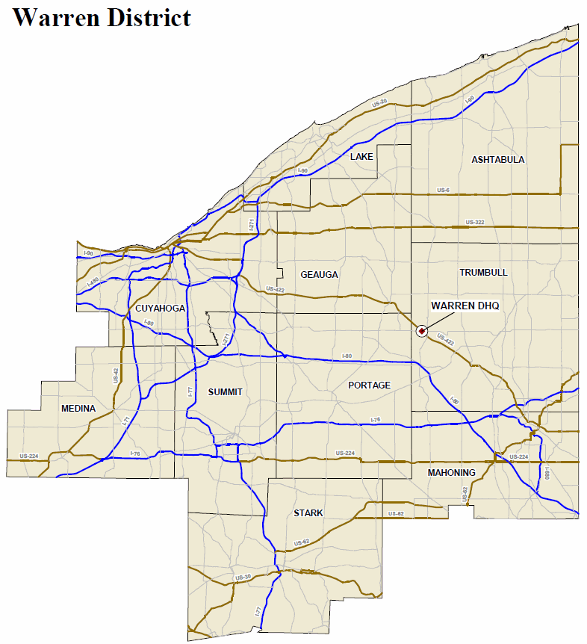
Contact Information – Warren District
County | OTSO Contact | LEL | OSP Patrol Post
Ashtabula | Jackie Stephenson | Rick Beverley | Ashtabula
Cuyahoga | Jackie Stephenson | Rick Beverley | Cleveland Metro
Geauga | Jackie Stephenson | Rick Beverley | Chardon
Lake | Jackie Stephenson | Rick Beverley | Chardon
Mahoning | Jackie Stephenson | Rick Beverley | Canfield
Medina | Jackie Stephenson | Rick Beverley | Medina
Portage | Jackie Stephenson | Rick Beverley | Ravenna
Stark | Jackie Stephenson | Rick Beverley | Canton
Summit | Jackie Stephenson | Rick Beverley | Canton
Trumbull | Jackie Stephenson | Rick Beverley | Warren
Contact Information:
OTSO: 614/466-3250
Rick Beverley: 330/697-1714
OSP Patrol Post: http://statepatrol.ohio.gov/Counties.stm

Slide 10
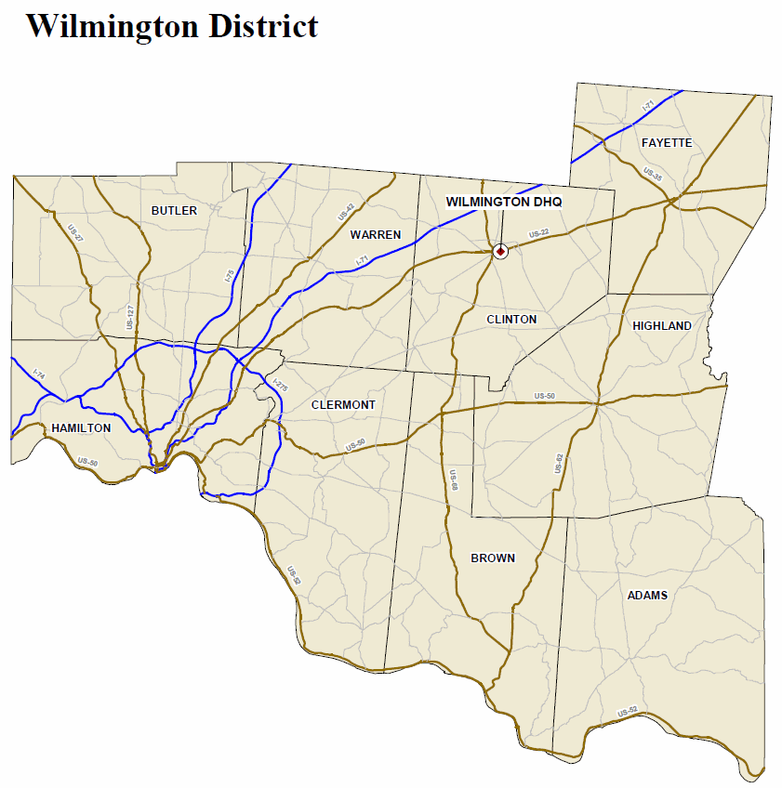
Contact Information – Wilmington District
Contact Information:
OTSO: 614/466-3250
Chris Robertson: 513/518-8548
OSP Patrol Post: http://statepatrol.ohio.gov/Counties.stm
County | OTSO Contact | LEL | OSP Patrol Post
Adams | Kelvin Williams | Chris Robertson | Georgetown
Brown | Kelvin Williams | Chris Robertson | Georgetown
Butler | Kelvin Williams | Chris Robertson | Hamilton
Clermont | Kelvin Williams | Chris Robertson | Batavia
Clinton | Kelvin Williams | Chris Robertson | Wilmington
Fayette | Kelvin Williams | Chris Robertson | Wilmington
Hamilton | Kelvin Williams | Chris Robertson | Cincinnati
Highland | Kelvin Williams | Chris Robertson | Wilmington
Warren | Kelvin Williams | Chris Robertson | Lebanon

Slide 11
Contact Information
Contact information may change throughout the year, OTSO will keep sub-grantees as up to date as possible.
These Contact Information slides will be updated as needed. Please refer back to these slides.

Slide 12
FFY 2014 Pre-Activity Form
Print the FFY 2014 Pre-Activity Form from http://ohiohighwaysafetyoffice.ohio.gov/FFY2014_Pre-ActivityForm.pdf. Use this form to follow along with this presentation.
Agency - enter your agency name.
Date – enter the date you are viewing this presentation.
County – enter the county where you are located.
Check the box to the left of HVEO.
Reimbursement Claim schedule – check monthly or quarterly. New sub-grantees must check monthly.

Slide 13
Activity Dates
Beginning Date – Grant period will commence after this required pre-activity presentation has been completed and the authorized to proceed date listed in the Award Letter.
Ending Date – All grant activity must be completed by September 30, 2014.
Check the box next to beginning and ending dates on the Pre-Activity form.

Slide 14
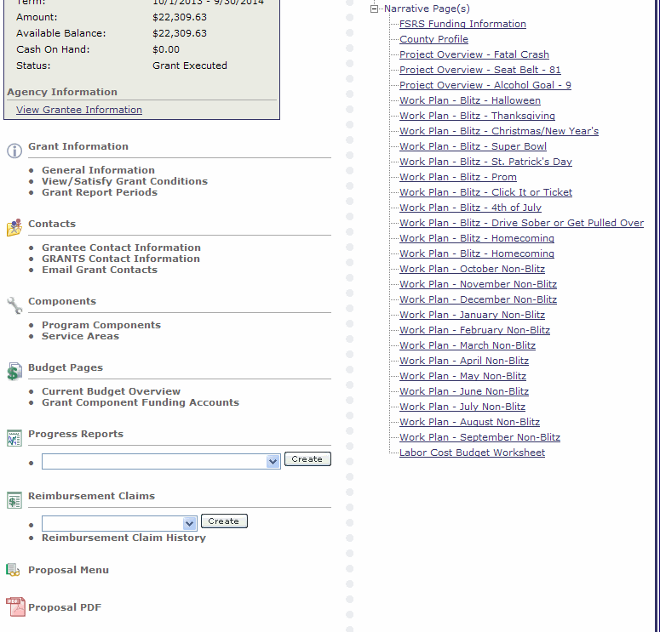
PDF
All sub-grantees need to generate a Full PDF of their grant outlining the goals, baselines, scopes of work, evaluations, work plans and the budget.
Click on Proposal PDF

Slide 15
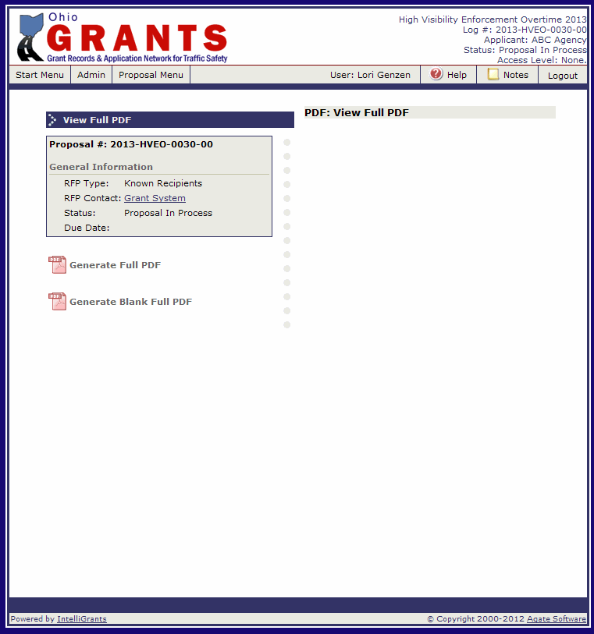
PDF
Click on Generate Full PDF.
This is an overnight process. The following morning you will receive an email stating that the PDF is ready. It will not be attached to the email.

Slide 16
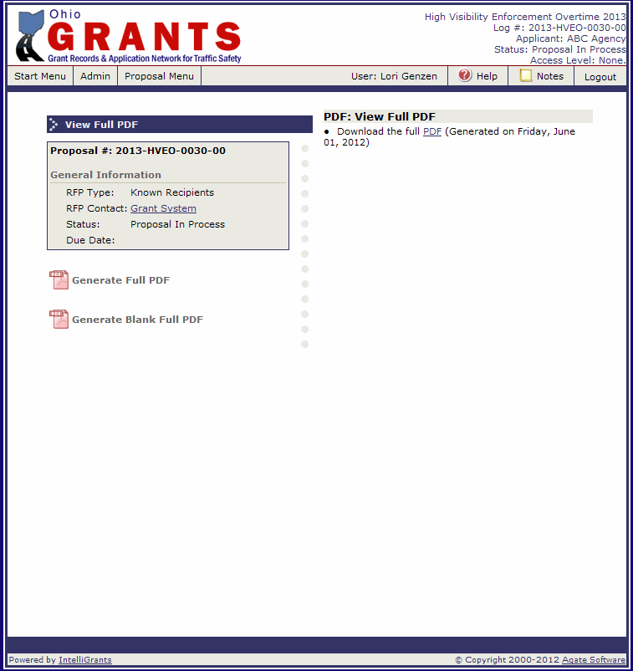
PDF
Return to this screen and click on the PDF on the right side.
Check the box next to Generate full PDF on the Pre-Activity Form.

Slide 17
Mandatory National Mobilizations
Click It or Ticket: May 19 – June 1, 2014
Drive Sober or Get Pulled Over: August 15 – September 1, 2014
HVEO grantees are required to participate and report in both National Mobilizations.
Check the box next to Mandatory National Mobilizations on the Pre-Activity Form.

Slide 18
Allowable Costs
Labor Expenses (Salaries and Wages)
The sub-grantee needs to maintain a coordinator (project director) throughout the grant.
Education Efforts (up to 5% of direct labor enforcement costs)
Fuel/Transportation Costs (up to 5% of direct labor enforcement costs – not education costs)
Refer to pages 31 – 32 of the Grant Solicitation Package for details on each cost category.

Slide 19
Unallowable Costs
Vehicle Mileage
Food
Paid Advertising/Public Communications
Equipment
Certain Labor Costs
Alcoholic Beverages
Lobbying
Grant Proposal Preparation and Submission
See pages 32 – 33 of the Grant Solicitation Package for details on each cost category.
Check the box next to Allowable and unallowable costs on the Pre-Activity Form.

Slide 20
Request to Purchase Form
Even if the item is approved in the grant, all purchases must be submitted to and approved by OTSO on a Request to Purchase form prior to incurring the cost.
A Request to Purchase form is required for:
Education Efforts
Any questions about whether or not a form is required, contact OTSO.
Check the box next to Request to Purchase form on the Pre-Activity Form.

Slide 21
Grant Revisions
Any changes, additions, or deletions to this agreement must be submitted online and approved by OTSO prior to implementing proposed changes.
A reimbursement claim cannot be submitted while a revision is in process. You must wait until the revision is finalized (approved or rejected). If you have a claim in process and you submit a revision – the revision will be rejected.
All revisions must be submitted online to OTSO by September 1, 2014.
Check the box next to Grant Revisions on the Pre-Activity Form.

Slide 22
Terms and Conditions
A complete list is on pages 12 – 28 of the FFY 2014 Grant Solicitation Package.
1) Agreement
Any inconsistencies between agreements and any attached documents shall be resolved in favor of the most current revised agreement on the online system, which shall be the controlling document.
18) Press Release
Each sub-grantee is required to submit a press release to their local media announcing the grant award, including amount and purpose of award.

Slide 23
Terms and Conditions
21) GRANTS User Accounts/Password Security
For security purposes, each person using the GRANTS system must have a separate user name and password. Each account must have its own email account. Sub-grantee agency personnel must not share passwords with agency staff or OTSO staff.
22) Labor Costs
All work (personnel labor costs) reimbursed under this grant must be for actual hours worked. Labor costs based on a percentage of hours worked will not be accepted for reimbursement. Leave hours (e.g., sick, vacation, personal, holiday, etc.) are not reimbursable as direct labor. The employer’s share of fringe benefits (e.g., retirement, Workers’ Compensation, Medicare, etc.) are eligible for reimbursement. Documentation verifying fringe percentages must be available to OTSO upon request.

Slide 24
Terms and Conditions
31) Training
The cost of training personnel for traffic safety purposes may be funded when the training supports both the goals and scope of work of the approved grant program and the goals of OTSO. All training requests and purchases must be submitted to and approved by OTSO on a Request to Purchase form prior to incurring the cost.
33) Reimbursement Claims
This agreement will operate on a reimbursement basis only. The administering agency must first incur the costs for approved expenditures and then apply for the reimbursement. Appropriate and accurate documentation will be required for each expense. Claim schedules are set up either monthly or quarterly based on sub-grantees selection on the pre-activity form. Any changes from this schedule must be made by the sub-grantee in writing. Each sub-grantee must submit reimbursement claims by the due date assigned to the claim in the GRANTS System.

Slide 25
Terms and Conditions
35) Narrative Progress Reports
The timetable for submission of narrative progress reports will be determined by OTSO. Each sub-grantee must submit progress reports by the due date assigned to the report in the GRANTS system.
38) Final Report and Final Claim
A final comprehensive annual project activity report must be submitted to OTSO by November 1.
Final reports not received by November 1 will result in a 10 percent penalty deduction to the final claim reimbursement.
If a final project activity report is received after November 15, the final claim will not be reimbursed.
A properly documented final claim for reimbursement must be submitted to OTSO by November 1.
Final claims not received by November 1 will result in a 10 percent penalty deduction in the final claim reimbursement.
Final claims received after November 15 will not be reimbursed.

Slide 26
Terms and Conditions
39) Records Retention
All records relating to project activity and/or expenditures must be maintained for review by representatives of the federal or state government for at least three years following the final reimbursement payment.
41) Termination of Agreement
Either OTSO or the sub-grantee may terminate this Agreement for any reason by giving the other party 30 days written notice. If the Agreement is cancelled under this provision, OTSO shall reimburse the sub-grantee for approved work completed and documented to that date. Upon termination all data results, reports and other materials developed by the sub-grantee will become the property of OTSO. All of the equipment, materials and/or supplies provided to the sub-grantee for use under this agreement must be returned to OTSO upon request within 30 days of said written notice. Should any change in federal funding adversely affect OTSO’s ability to complete the fiscal year’s activities, OTSO has the right to revise or terminate the agreement in writing.

Slide 27
Terms and Conditions
43) Enforcing Seat Belt Laws
The agency will enforce all seat belt and child restraint laws on all traffic stops made under this grant.
46) Mandatory Blitzes
Funding for all OTSO identified blitzes must be used for saturation patrols and OVI checkpoints only. Directing traffic, conducting parking detail at events, crash investigations, any non-traffic safety related activities, or any activities not identified in scope of work or work plan are not reimbursable activities.
47) National Enforcement Campaigns
All agencies utilizing overtime enforcement funds from OTSO are required to participate in the “Click It or Ticket” (CIOT) mobilization and the “Drive Sober or Get Pulled Over” (DSOGPO) alcohol crackdown.

Slide 28
Terms and Conditions
48) Press Releases
In addition to the grant award press release, OVI Task Forces are required to conduct three press conference events (one in coordination with DSOGPO), promote the task force through press releases and publicize checkpoints as required by law.
50) Monthly Enforcement Reports
Whether or not a sub-grantee conducts grant-related activity, each sub-grantee must submit an enforcement report monthly. The monthly enforcement report must be submitted online to OTSO by the 15th calendar day of the following month. Failure to submit these reports in a timely manner will cause a delay in payment of claims, may jeopardize funding for present and future projects and may result in being placed in “Sub-grantee on Notice” status.
Check the box next to Terms and Conditions on the Pre-Activity form.

Slide 29
High Visibility Enforcement Overtime Grant
GRANTS System
Report, Reimbursement Claim and Revision Process

Slide 30
Monthly Enforcement Report
A monthly enforcement report is due for each month. Even if there is no grant activity, a report must be submitted.
Each monthly enforcement report is broken down into four forms:
Daytime Enforcement Activity
Nighttime Enforcement Activity
Daytime Sobriety Checkpoint Activity
Nighttime Sobriety Checkpoint Activity
Each monthly enforcement report is due the 15th of the following month (example: October enforcement report is due November 15th).

Slide 31
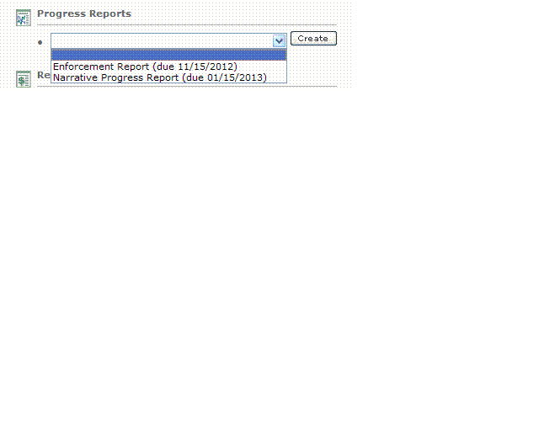
Progress Reports
Progress reports will be listed in the drop down under Progress Reports.
Reports will be in the drop down
the first day of the reporting
period. (Ex. May Enforcement
Report will be in the drop down
May 1st).
The date listed after the report name is the date the report is due. If a report is past due, you will not be able to submit a claim (or re-submit a claim that was sent back for modifications).
1
1
2

Slide 32
Monthly Enforcement Reports
To initiate the report:
Select the report from the drop down menu.
2. Click the “Create” button.
2
1

Slide 33
Enforcement Report Menu
General Information Box lists the report title, the current status of the report, the due date of the report and the period that this report covers.
Final Report: Default is “no”. This is correct until the last enforcement report for the year (September). If you tell the system “yes”, the system will not generate additional enforcement reports.
Grant Report Forms: List of all forms in the Enforcement Report.
2
1
3

Slide 34
Enforcement Report
Click on Daytime Enforcement Report to begin filling out the forms.

Slide 35
Daytime Enforcement Report
Enter the agency name.
Select the month from the drop down.
Enter the number of days the project was in operation. (Ex. If the project only ran from October 15 – 20, then enter 6).
This column is for activity that was done on saturation patrols, corridor enforcement, etc. on this grant between 6am and 6pm.
Highlight – List any activity highlights that occurred during the month.
Click “Save”.
After the page processes, the YTD totals will self-calculate.
Click “Next”.
If you do not have any activity between 6am and 6pm to enter on this form, do not click in any field. Click “Next”. Once you click in any field, however you must complete each box with a *.
6
8
1
2
3
4
7
5

Slide 36
Nighttime Enforcement Report
Enter the agency name.
Select the month from the drop down.
Enter the number of days the project was in operation. (Ex. If the project only ran from October 15 – 20, then enter 6).
This column is for activity that was done on saturation patrols, corridor enforcement, etc. on this grant between 6pm and 6am.
Highlight – List any activity highlights that occurred during the month.
Click “Save”.
After the page processes, the YTD totals will self-calculate.
Click “Next”.
If you do not have any activity between 6pm and 6am to enter on this form, do not click in any field. Click “Next”. Once you click in any field, however you must complete each box with a *.
6
8
1
2
3
4
7
5

Slide 37
Daytime Sobriety Checkpoint
This form is for checkpoints that start (not set up or pre-check point meeting) between 6am and 5:59pm. Do not split a checkpoint into two forms.
Enter the site.
Enter the jurisdiction the checkpoint is in.
Enter the date the checkpoint started.
Enter the Start and End time (include pre-check point meeting through tear down).
1
2
3
4
5
6
7
Enter the agencies participating in the checkpoint.
Enter the number of officers that worked the checkpoint.
Enter the number of hours that are being reimbursed on the grant.

Slide 38
Daytime Sobriety Checkpoint
This column is for activity that was done at a checkpoint on this grant.
Highlight – List any activity highlights that occurred at the checkpoint.
Click “Save”.
If you did not have a checkpoint between 6am and 5:59pm to enter on this form, do not click in any field. Click “Next”. Once you click in any field, however you must complete each box with a *.
8
9
10

Slide 39
Daytime Sobriety Checkpoint
After hitting save, allow the page to process, once it has processed the YTD figures will self-populate.
If you need to enter another form, hit “Add” and repeat steps 1 -10 on the previous two slides.
If you are done entering daytime sobriety checkpoint activity, click “Next”.
Note: If a checkpoint is set up in one location, tore down, moved and set up in another location that counts as two different checkpoints. You need to complete two checkpoint forms.
2
3
1

Slide 40
Nighttime Sobriety Checkpoint
This form is for checkpoints that start (not set up or pre-check point meeting) between 6pm and 5:59am. Do not split a checkpoint into two forms.
Enter the site.
Enter the jurisdiction the checkpoint is in.
Enter the date the checkpoint started.
Enter the Start and End time (include pre-check point meeting through tear down).
1
2
3
4
5
6
7
Enter the agencies participating in the checkpoint.
Enter the number of officers that worked the checkpoint.
Enter the number of hours that are being reimbursed on the grant.

Slide 41
Nighttime Sobriety Checkpoint
This column is for activity that was done at a checkpoint on this grant.
Highlight – List any activity highlights that occurred at the checkpoint.
Click “Save”.
If you did not have a checkpoint between 6pm and 5:59am to enter on this form, do not click in any field. Click “Next”. Once you click in any field, however you must complete each box with a *.
8
9
10

Slide 42
Nighttime Sobriety Checkpoint
After hitting save, allow the page to process, once it has processed the YTD figures will self-populate.
If you need to enter another form, hit “Add” and repeat steps 1 -10 on the previous two slides.
If you are done entering nighttime sobriety checkpoint activity, click “Next”.
Note: If a checkpoint is set up in one location, tore down, moved and set up in another location that counts as two different checkpoints. You need to complete two checkpoint forms.
2
3
1

Slide 43
Enforcement Report Attachments
Use this form to attach documents to your enforcement report (press releases, news articles, etc.). Do not attach claim related documentation to your report.
Give a brief description of the document.
Click “Browse” to search your computer for the file.
Click “Save”.
Click “Add” and repeat steps 1 – 3 to add additional attachments.
When done adding attachments, click “Report Menu”.
NOTE: When attaching PDFs, make sure the file name does NOT include any special characters (&, #, %, etc.)
5
4
3
1
2

Slide 44
Enforcement Report Menu
When you are certain all data has been entered accurately and completely, click “Check Errors” to see if there are any system errors to fix prior to submitting.
If you would like a PDF of the report to print or save to your computer, click “Generate Full PDF”.
If there are no errors, click the “Submit” button.
3
1
2

Slide 45
Report Submitted
Once your report is successfully submitted, you will see a confirmation at the top of the screen and the status will change in the General Information box.
Click “Grant Menu” to return to the Grant.

Slide 46
Narrative Progress Report
A narrative progress report is required for each quarter. It is due the 15th of the month following the end of the quarter. (Example: The first quarter (October – December) is due January 15th.)

Slide 47
Narrative Progress Reports
To initiate the report:
Select the report from the drop down menu.
Click the “Create” button.
1
2

Slide 48
Narrative Progress Report Menu
General Information Box lists the report title, the current status of the report, the due date of the report and the period that this report covers.
Final Report: Default is “no”. This is correct until the last narrative report for the year (July - September). If you tell the system “yes”, the system will not generate additional narrative reports.
Grant Report Forms: List of all forms in the Narrative Progress Report.
2
1
3

Slide 49
Narrative Progress Report
Click on Fatal Crash Goal Progress to begin filling out the forms.

Slide 50
Fatal Goal Progress
The report pulls forward your goal, baseline and evaluation from your grant.
Using your evaluation as a guide, enter the current status of the goal. Example: This quarter we had 1 traffic-related fatal crash. Last year we had 2 traffic-related fatal crashes during the same time frame.
Click “Save”.
After the page has processed, click “Next”.
2
3
1

Slide 51
Seat Belt Goal Progress
The report pulls forward your goal, baseline and evaluation from your grant.
Using your evaluation as a guide, enter the current status of the goal. Example: The current seat belt rate provided by Miami University is 75% or the seat belt rate has not been updated by Miami University.
Click “Save”.
After the page has processed, click “Next”.
2
3
1

Slide 52
Alcohol Goal Progress
The report pulls forward your goal, baseline and evaluation from your grant.
Using your evaluation as a guide, enter the current status of the goal. Example: This quarter we had 0 alcohol-related fatal and serious injury crashes. Last year we had 1 alcohol-related fatal and serious injury crash during the same time frame.
Click “Save”.
After the page has processed, click “Next”.
2
3
1

Slide 53
Other Grant Related Information
10
Enter any accomplishments during this quarter.
Enter any training conducted during this quarter.
Enter any Public Information & Education efforts during this quarter.
Enter any partnerships made this quarter.
Enter any challenges that occurred this quarter.
Enter any legislation during this quarter.
Enter any Educational / Promotional Materials purchased during this quarter.
Answer whether or not the materials were approved by OTSO – if no, explain why not.
Enter any local evaluations or surveys conducted during this quarter.
Click “Save”.
Note: If there was no activity in any of these fields for the quarter, enter none or n/a.
1
2
3
4
5
6
7
8
9

Slide 54
Other Grant Related Information
After the page has been saved, click “Report Menu”.

Slide 55
Narrative Progress Report Menu
When you are certain all data has been entered accurately and completely, click “Check Errors” to see if there are any system errors to fix prior to submitting.
If you would like a PDF of the report to print or save to your computer, click “Generate Full PDF”.
If there are no errors, click the “Submit” button.
3
1
2

Slide 56
Report Submitted
Once your report is successfully submitted, you will see a confirmation at the top of the screen and the status will change in the General Information box.
Click “Grant Menu” to return to the Grant.

Slide 57
Annual Report
A final comprehensive annual project activity report must be submitted to OTSO by November 1.
Final reports not received by November 1 will result in a 10 percent penalty deduction to the final claim reimbursement.
If a final project activity report is received after November 15, the final claim will not be reimbursed.
The annual report will be available in the GRANTS System by August 31, 2014.

Slide 58
Annual Report
To initiate the report:
Select the report from the drop down menu.
Click the “Create” button.
2
1

Slide 59
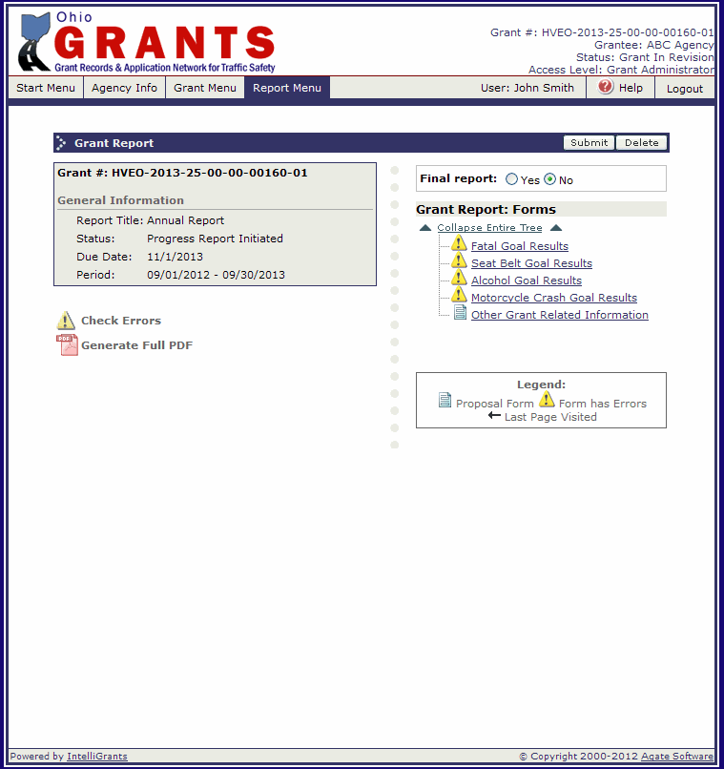
Annual Report Menu
General Information Box lists the report title, the current status of the report, the due date of the report and the period that this report covers.
Final Report: Default is “no”. Change to “Yes”.
Grant Report Forms: List of all forms in the Annual Report.
2
1
3

Slide 60
Annual Report Menu
Click on Fatal Goal Results to begin filling out the forms.

Slide 61
Fatal Goal Results
The report pulls forward your goal and baseline from your grant.
Using the goal, enter the end result compared to the goal and why or why not. Ex: This year we had 4 fatal crashes exceeding our goal of 5. We were able to exceed our goal due to the concentration of enforcement in our problem areas or we have had 6 fatal crashes; we did not meet our goal of 5. We did not meet our goal because we had more motorcycle fatal crashes this year.
Click “Save”.
After the page has processed, click “Next”.
2
3
1

Slide 62
Seat Belt Goal Results
The report pulls forward your goal and baseline from your grant.
Using the goal, enter the end result compared to the goal and why or why not. Ex: The current seat belt usage rate provided by Miami University is 78%. We were able to exceed our goal by increasing seat belt enforcement or the current seat belt usage rate provided by Miami University is 75%. We did not meet our goal because XXXX.
Click “Save”.
After the page has processed, click “Next”.
2
3
1

Slide 63
Alcohol Goal Results
The report pulls forward your goal and baseline from your grant.
Using the goal, enter the end result compared to the goal. Ex: This year we had 49 alcohol-related fatal and serious injury crashes exceeding our goal of 50. We were able to exceed our goal due to the concentration of enforcement in our problem areas or we have had 52 alcohol-related fatal and serious injury crashes; we did not meet our goal of 50. We did not meet our goal because we had more alcohol-related motorcycle crashes this year.
Click “Save”.
After the page has processed, click “Next”.
2
3
1

Slide 64
Other Grant Related Information
Describe any partnerships made during the grant year.
List any other funding or in-kind resources that were obtained during the grant year.
Describe any challenges during the grant year and how they were resolved.
Describe any highlights or noteworthy activities that happened during the grant year.
Click “Save”.
After the page has been saved, click “Report Menu”.
6
5
1
2
3
4

Slide 65
Annual Report Menu
When you are certain all data has been entered accurately and completely, click “Check Errors” to see if there are any system errors to fix prior to submitting.
If you would like a PDF of the report to print or save to your computer, click “Generate Full PDF”.
If there are no errors, click the “Submit” button.
3
1
2

Slide 66
Report Submitted
Once your report is successfully submitted, you will see a confirmation at the top of the screen and the status will change in the General Information box.
Click “Grant Menu” to return to the Grant.

Slide 67
Report Submitted Process
Once the report has been submitted to our office, it goes through a review process.
The report will be under “Progress Report Submitted” until the review is complete.
If it is approved, it will be under “Progress Report Approved”.
If it is sent back for modifications, you will receive an email and it will be under “Progress Report Modifications Required”.
Log into the GRANTS System to make the modifications.
Note: If you do not receive the email, check your email address in the GRANTS System (update if needed) or check with your agency IT Administrator to see if our system generated emails from otso@dps.state.oh.us are being blocked as spam.

Slide 68
Report Modifications
On the Start Menu, under the Task List, any items that need modifications will be listed.
Click on the link for the report you want to modify.
1
2

Slide 69
Report Modification
Modifications that are required will be listed on the Report Menu outlined in a red box.
Complete the changes, return to the Report Menu and click “Submit” to re-submit the report.
Check the box next to Report Process on the Pre-Activity Form.
2
1

Slide 70
Reimbursement Claim Process
Reimbursement claims will be due either the 15th of the following month for monthly claims (Example: October claim will be due November 15th) or the 15th of the month following the end of the quarter (Example: First quarter claim (October – December) will be due January 15th).
Verify your claim schedule selection on the Pre-Activity Form. New sub-grantees must select monthly.
Reimbursement claims can include previous activity but cannot go beyond the current claim period. (Example: The December claim can include a November expense, but not a January expense).
If there is no activity, you must submit a zero claim.

Slide 71
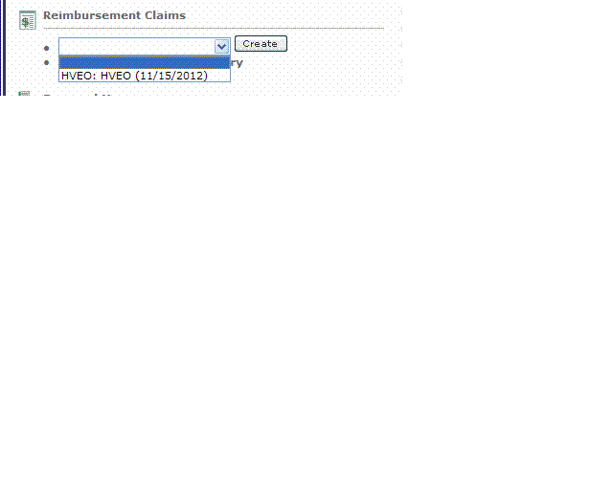
Reimbursement Claim Process
Reimbursement Claims will be listed in the drop down under Reimbursement Claims.
Claims will be in the drop down the first day of the claim period. (Ex. May Claim will be in the drop down May 1st).
The date listed is the date the claim is due. If a progress report is past due, you will not be able to submit a claim (or re-submit a claim that was sent back for modifications).
Only one claim can be processed at a time. The next claim will not show up in the drop down until the previous one has been approved.
2
1

Slide 72
Reimbursement Claim Process
To initiate the reimbursement claim:
Select the claim from the drop down menu.
2. Click the “Create” button.
1
2

Slide 73
Reimbursement Claim Process
The Expense Summary Page shows grant information.
Budget Information
Previous Expenses will show after the first claim has been approved.
Budget Remaining (Award – Previous Claim)
Current Period Expenses (once you add Expense Detail items these fields will self-populate).
Every time a subsequent claim is initiated, the previous expenses and budget remaining will update to include all previous approved claims.
6. Click the “Edit” button.
6
1
2
3
4
5

Slide 74
Reimbursement Claim Process
Unless it is the final claim for the year, select “No” for Final Report. If you select “Yes” the system will not issue any more Reimbursement Claims.
Enter the reporting period. Typically it would be the beginning of the month (or quarter) to the end of the month (or quarter). However, if you need to claim an expense from a previous reporting period you will need to make the beginning date the date of the earliest expense. (Ex. November claim would normally be 11/1/2012 to 11/30/2012. If you have an invoice from 10/17/2012 to claim, the reporting periods would be 10/17/2012 to 11/30/2012).
Comments – If you have any comments/notes you would like the OTSO review team to see regarding your reimbursement claim, enter them here.
Click the “Save” button.
Click the “Expense Detail” tab.
5
4
1
3
2

Slide 75
Reimbursement Claim Process
Use this screen to enter each expense for the reimbursement claim. The fields required for each expense will change based on the budget category selected.
Select the budget category from the drop down. Make sure you are putting the expense in the appropriate category.
Wait for the page to refresh.
1

Slide 76
Reimbursement Claim Process
Direct Labor
Item: Not required
Budget Column: Select from the drop down. This will show how much you have remaining in this budget category.
Name/Title – Enter the Employee’s Name and Title.
Begin Date/End Date – Enter the beginning date and ending dates of the labor that is being claimed.
Activity Description –If claiming for blitz, mark the blitz name. If claiming for non-blitz, mark the activity non-blitz. If you have a person that worked a combination of these activities on the same date range, break the hours out in the activity description. (Ex. Halloween Blitz – 4 hours. Non-Blitz 4 hrs.)
Check Number – Enter either a check number if the person was paid with a check, or enter DD or EFT if the person was paid with Direct Deposit.
Enter the number of hours for that date range.
Enter the actual hourly rate the employee was paid, not the rate entered in the proposal.
Click the “Save” button.
NOTE: OTSO only pays for OT that has been paid out to the employee. Comp Time is not allowable.
9
1
2
3
4
5
6
7
8

Slide 77
Reimbursement Claim Process
Once saved, the information will self-calculate and appear below the Add an Expense Item Box. As you continue to add expenses, they will continue to appear at the bottom.
Select another budget category from the drop down and wait for the page to refresh to continue adding line items to the reimbursement claim.
1

Slide 78
Reimbursement Claim Process
Labor Fringe Benefits
Item: Not required
Budget Column: Select from the drop down. This will show how much you have remaining in this budget category.
Date Worked/End Date – Enter the date range to cover the direct labor worked in the claim.
Description – enter how you calculated the fringe. (Ex. $1,500 Direct Labor X 21.75% = $326.25) Make sure description amount matches the Fringe Calculation (especially if the claim is returned for modifications).
Fringe Calculation – enter the amount of fringe you are claiming.
Click the “Save” button.
6
1
2
3
4
5
Note: Make sure you are claiming the actual amount of fringe that is being paid. Ex: If Worker’s Comp was 2.4% when you submitted the proposal and your agency is actually paying 1.7%, you can only claim 1.7%.
Make sure you are not claiming a higher percentage than you have been approved for in the grant. If you were approved for 21.75% you are not allowed to claim 24.5% without having a revision approved. You are allowed to claim less than you were approved for.

Slide 79
Reimbursement Claim Process
Other Direct Costs
Item: Not required.
Budget Column: Select from the drop down. This will show how much you have remaining in this budget category.
Name/Description – Enter “fuel/transportation cost”
Enter the activity date (if the activity spans the entire month, put the last day of the month).
Enter the Check or Warrant number used to pay for the item.
7
1
2
3
4
5
6
Enter the cost of the item.
Click the “Save” button.

Slide 80
Reimbursement Claim Process
Once all entries have been made, review for accuracy.
If you find an expense line that has an error:
Click the radio button next to the item that needs correction.
If the entire line needs deleted (duplicate entry), click “Delete”.
If you just need to make changes, click “Edit”.
3
2
1

Slide 81
Reimbursement Claim Process
After you click edit, the top box will populate with the information previously entered.
Make the necessary changes and click the “Save” button.
When you are certain all expenses have been entered accurately and completely, click the “Expense Summary” tab.
2
1

Slide 82
Reimbursement Claim Process
If you need to attach documentation to support charges in the reimbursement claim (invoices, task force invoices, travel receipts, etc.), click the “Claim Attachments” tab.

Slide 83
Reimbursement Claim Process
Click “Add”.

Slide 84
Reimbursement Claim Process
Enter the title of the attachment. (Example: Travel Receipts)
Click “Browse” to locate the file on your computer.
Once the document is showing in the file path, click “Save”.
NOTE: When attaching PDFs, make sure the file name does NOT include any special characters (&, #, %, etc.)
3
1
2

Slide 85
Reimbursement Claim Process
If you need to attach additional documentation, click “Add” and follow steps 1 – 3 on the previous slide.
Once you have attached all documentation, click “Back to Claim”
2
1

Slide 86
Reimbursement Claim Process
The Current Period Expenses have now been totaled from the entries.
Click “Check for Errors” to see if there are any system errors to fix prior to submitting.
Reminder, you cannot submit a reimbursement claim if you have progress reports that are past due.
If there are no errors, click the “Submit” button.
You will be asked to enter your password.
1
2

Slide 87
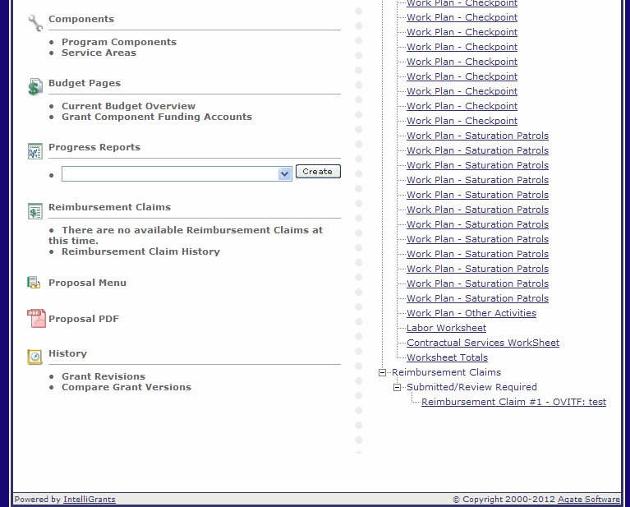
Reimbursement Claim Process
Once the claim has been submitted to our office, it goes through a review process.
The claim will be under “Submitted/Review Required” until the review is complete.
If it is approved, it will be under “Approved”. OTSO normally processes payments weekly (holiday weeks may alter schedule).
Once the claim has been processed for payment, it will be under “Payment Initiated”.
Payment should be received 2 – 3 weeks after they have been marked “Payment Initiated”.
When the check is sent, the claim will be under “Payment Complete”. If you receive a paper check, this means it was put in the mail. If you receive EFT, payment should be in your account.

Slide 88
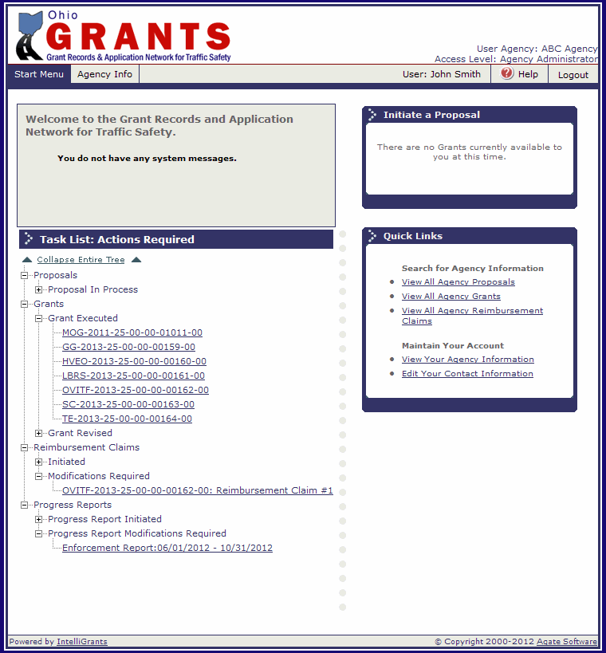
Reimbursement Claim Process
If your claim is not approved, it will be under “Modifications Required” and you will receive an e-mail letting you know it has been returned.
Return to the GRANTS System and the claim will be under your task list.
Note: If you do not receive the email, check your email address in the GRANTS System (update if needed) or check with your agency IT Administrator to see if our system generated emails from otso@dps.state.oh.us are being blocked as spam.

Slide 89
Reimbursement Claim Modifications
Modifications that are required will be listed on the Expense Summary outlined in a red box.
Click on Expense Detail to make the corrections.
Note: There are limited characters available, check with your planner if the comment is not complete.

Slide 90
Expense Detail Modifications
The Comments are still at the top of the screen for reference.
Find the line item you need to correct, select the radio button.
To make changes to the entry, click “Edit”.
To delete the entry, click “Delete”.
1
3
4
2

Slide 91
Expense Detail Modifications
The top box will populate with the information previously entered.
Make the corrections in the top box.
Click “Save”.
To make corrections on the claim attachment page, click “Claim Attachments” tab.
If all corrections are complete, click “Expense Summary”.
5
4
3
1
2

Slide 92
Claim Attachment Modifications
To modify the current attachment, check the box next to the attachment.
To delete, click “Delete”.
To edit, click “Edit”.
To add additional files, click “Add”.

Slide 93
Claim Attachment Edit
Change the title, or
Attach an updated file by clicking “Browse”.
Click “Save”.
3
1
2

Slide 94
Claim Attachment Add
Enter the title.
Click “Browse” to locate the file on your computer.
Click “Save”.
3
1
2

Slide 95
Claim Attachment Modification
When done deleting, editing and adding attachments, click “Back to Claim”.

Slide 96
Reimbursement Claim Modifications
Verify that all the corrections mentioned in the Review Comments have been made. If they have, click “Submit”.

Slide 97
Electronic Reimbursement
Reimbursement can be received electronically by going to :
http://ohiosharedservices.ohio.gov/Vendors.aspx
Check the box next to Reimbursement Claim Process on the Pre-Activity Form.

Slide 98
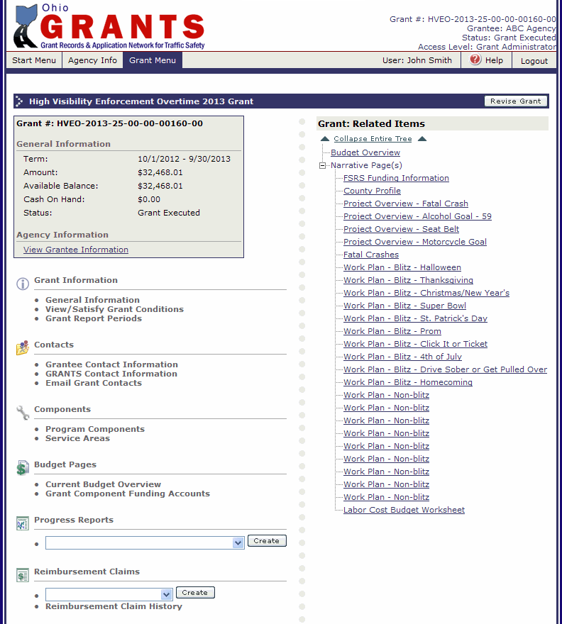
Revision Process
All grant revisions must be submitted by September 1, 2014.
To initiate a revision, click “Revise Grant”.

Slide 99
Grant Revision
Once you click “Revise Grant”, you will receive this warning message:
Once a revision has been initiated do not initiate a new reimbursement claim, and any initiated reimbursement claims including modifications cannot be submitted until the revision has been fully approved.

Slide 100
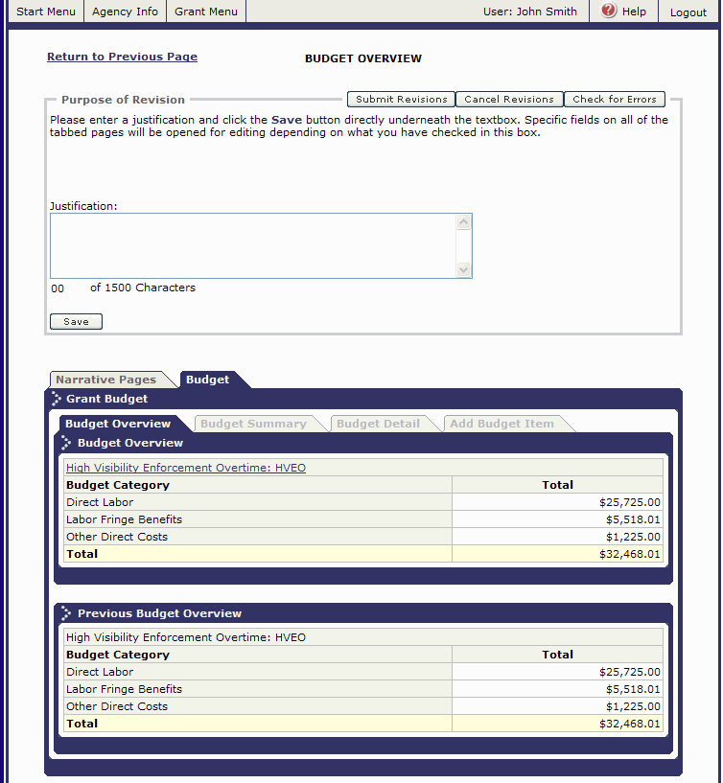
Grant Revision
The Budget Overview Page has the Justification. All changes you are making to the grant need to be listed in this box. Ex: Moved 20 hours from Christmas to St. Patrick’s Day. Moved 10 hours from November Non-Blitz to February Non-Blitz.
If you need to wait until you have made your changes to fill this in, make sure you return to this page when you enter the justification. (It is the only time the “Save” button will appear).

Slide 101
Narrative Page Revisions
To make changes to any Narrative Page (FSRS Funding Information, County Information, Goals, Work Plans, Labor Cost Budget Worksheet), click “Narrative Pages” tab.

Slide 102
Narrative Page Revisions
Select the page you want to revise in the drop down and click “go”.
Once it pulls up the information from the grant, you will see the information in two boxes. The bottom box is what was in the grant previously.
Make changes in the top box.
Click “Save”.
1
3
2

Slide 103
Narrative Page Revisions
To select another Narrative Page, choose the name and click “go”.
If that page has multiple pages, select the one from the drop down and click “go” or click “next” to scroll through.
Again, make changes in the top box.
Click “Save”.
If you need to add a new page, click “add”.
2
1
3
5
4

Slide 104
Narrative Page Revisions
After you click “Add”, a blank form will come up. Complete and click “Save” just like on the proposal.
Note: There will not be a bottom box for new pages, there was no previous page to compare it to.

Slide 105
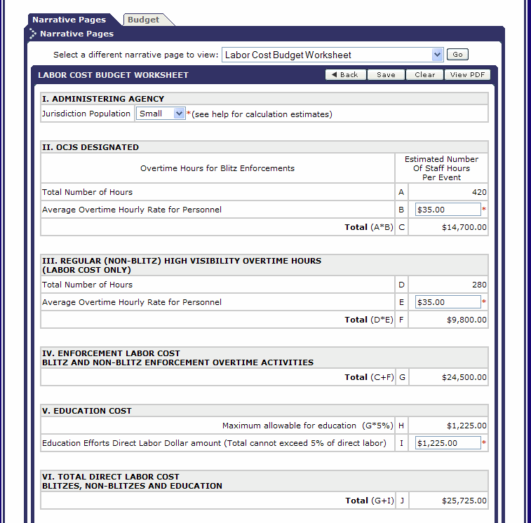
Narrative Page Revisions
If you have made changes to any work plan pages, you will need to re-save the Labor Cost Budget Worksheet.
Select Direct Labor Worksheet in the drop down, click “go”.
1

Slide 106
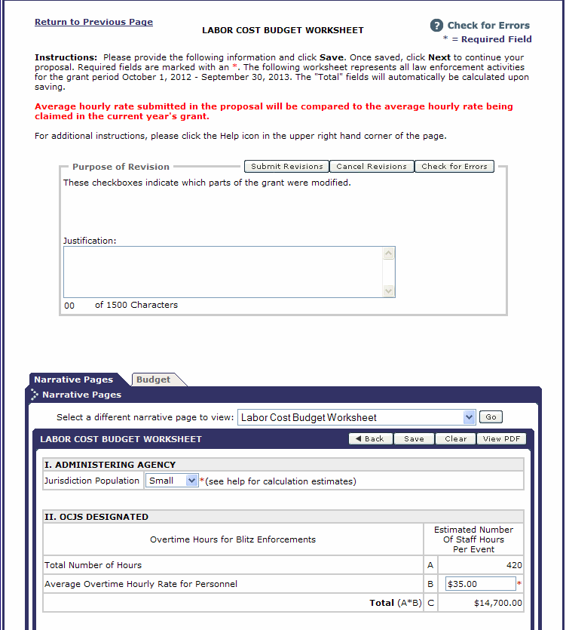
Narrative Page Revisions
Once the page refreshes, click “Save”.
If you have completed the Justification box, click “Submit Revisions”.
If you need to complete the Justification box, click the “Budget” tab.
2
3
1

Slide 107
Grant Revision
Complete the Justification Box.
Click “Save”.
Compare the Budget Overview to the Previous Budget Overview to ensure that the budget has not increased (unless you have prior approval to increase your budget) or decreased (unless you wish to decrease the budget).
Click “Check for Errors” to see if there are any system errors to fix prior to submitting.
Click “Submit Revisions”.
4
5
1
2
3

Slide 108
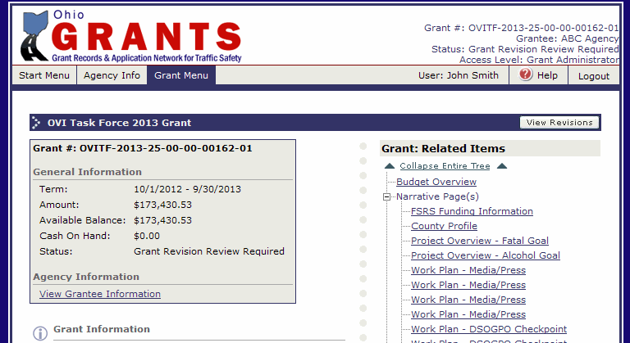
Grant Revisions
Once the revision has been submitted to our office, it goes through a review process.
The grant will be under “Grant Revision Review Required” until the review is complete.
If it is approved, the grant status will update to “Grant Revised”.

Slide 109
Grant Revision Modifications Required
If your revision is not approved, it will be under “Grant Revision Modifications Required” and you will receive an e-mail letting you know it has been returned.
Return to the GRANTS System and the claim will be under your task list. Click on the link.
Note: If you do not receive the email, check your email address in the GRANTS System (update if needed) or check with your agency IT Administrator to see if our system generated emails from otso@dps.state.oh.us are being blocked as spam.

Slide 110
Grant Revision Modifications Required
From the Grant Menu, click on “View Revisions”.

Slide 111
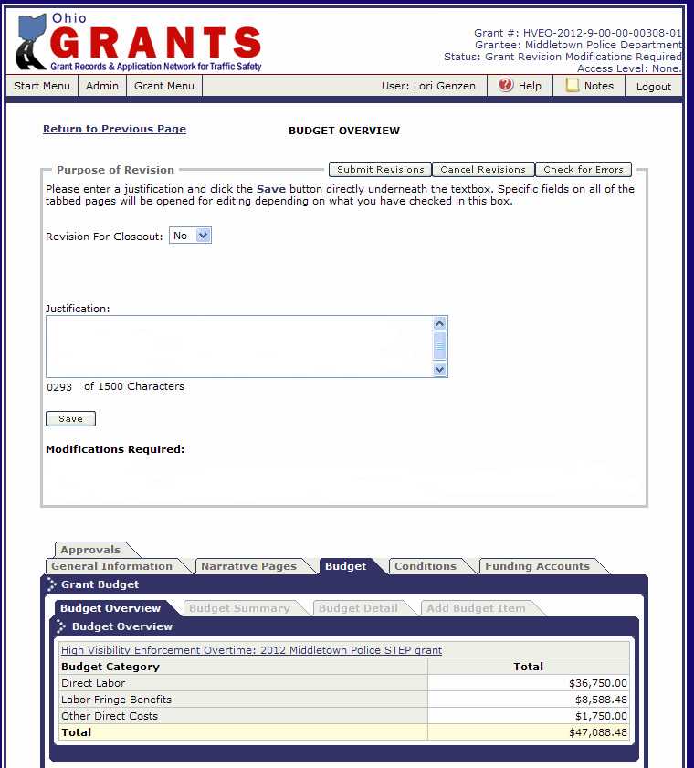
Grant Revision Modifications Required
Modifications that are required will be listed on the Budget Overview under Modifications Required.
Follow the steps on slides 100 -107 to make the required changes and re-submit the revision.
Check the box next to Revision Process on the Pre-Activity form.

Slide 112
Controlling Access to Grant
To change/add personnel to the grant:
Click “Grantee Contact Information”.

Slide 113
Controlling Access to Grant
The people who were added to the proposal are automatically transferred to the grant.
If you need to make changes to the existing contact type or level of access:
Click the radio button next to the name.
Click the “Edit” button and make the necessary changes.
2
1

Slide 114
Controlling Access to Grant
Make the change to either the Contact Type or the Level of Access.
Contact Types
Authorizing Official – The authorizing official is usually the head of an organization/agency. This individual must possess or have the ability to obtain the legislative authority to enter into an agreement with OTSO.
Project Director – The project director is designated as the agency’s liaison with OTSO by the authorizing official. This individual will oversee the daily activities of the grant and ensure that the scope of work, evaluation and work plans are completed as proposed. This individual will also serve as the primary contact person for the grant.
Fiscal Officer – The fiscal officer is responsible for the fiscal activities of the agency. This individual is responsible for overseeing the grant’s budget, as well as submitting properly prepared claims for reimbursement to OTSO.
Level of Access
Grant Administrator – has access to make changes, submit reports and reimbursement claims.
Viewer – Can only view the grant.
Click “Save”.
2
1

Slide 115
Controlling Access to Grant
If you need to delete an existing contact from the grant:
Click the radio button next to the name.
Click the “Delete” button.
This will only remove the person’s access to this grant. It does not remove their access to the GRANTS System. See Slide 119 if you need to de-activate their account.
2
1

Slide 116
Controlling Access to Grant
To add additional people:
Select the person’s name.
Select the Contact Type (Authorized Official, Fiscal Officer, etc.)
Select level of access.
Click the “Grant This User Access” button.
Repeat until all necessary people have been added.
If the person that needs to be added, is not listed in the drop down for Step 1:
Click “Agency Info”.
5
4
1
2
3

Slide 117
Controlling Access to Grant
To add a new user:
If you are the Agency Administrator, click the “Add” button and complete the user information. If you are not the Agency Administrator, have the Agency Administrator complete this step. Then proceed to Step 2.
Once everyone that you need to add to the grant is added, click on “Back to Previous Page”.
2
1

Slide 118
Controlling Access to Grant
To add additional people:
Select the person’s name.
Select the Contact Type (Authorized Official, Fiscal Officer, etc.)
Select level of access.
Click the “Grant This User Access” button.
Repeat until all necessary people have been added.
Click “Grant Menu” to return to your grant or “Start Menu” to return to your task list.
5
4
1
2
3

Slide 119
Controlling Access to GRANTS
To manage user’s access click on “Agency Info”.
To edit existing users, click the radio button next to the user’s name.
Click “Edit”.
2
1

Slide 120
Controlling Access to GRANTS
To de-activate the user (they will no longer be able to access the GRANTS System), click the box next to “Active” – this will remove the checkmark.
To update address, phone number, email address, etc. – make the change in the appropriate field.
Click “Save”.
3
2
1

Slide 121
Agency Information
If the agency information needs updated (address, phone number), click “Edit”.

Slide 122
Agency Information
Make changes.
Click “Save”.
Only the fields outlined with a box can be edited. If you need information updated that is not accessible please email otso@dps.state.oh.us
Check the box next to controlling access to the grant and the GRANTS system on the Pre-Activity form.
2
1

Slide 123
Pre-Activity Form Completion
Once you have finished the presentation, sign the completed form and fax it to 614-752-4646 or scan and email to otso@dps.state.oh.us
Save this presentation as a user guide throughout the grant year for claims, reports and revisions.

Slide 124
Questions?
If you have any questions, please email your questions to otso@dps.state.oh.us
OTSO will be developing FAQ sheets; please do not hesitate to send questions to the above email address. The FAQ sheets will be developed in part from questions we receive.

