Slide 1
Ohio Traffic Safety Office
FFY 2015 General Grant Pre-Activity Presentation

Slide 2
Who Should View?
The Project Director is required to view the Pre-Activity Presentation and complete the Pre-Activity form.
The Fiscal Officer is encouraged to view the presentation.

Slide 3
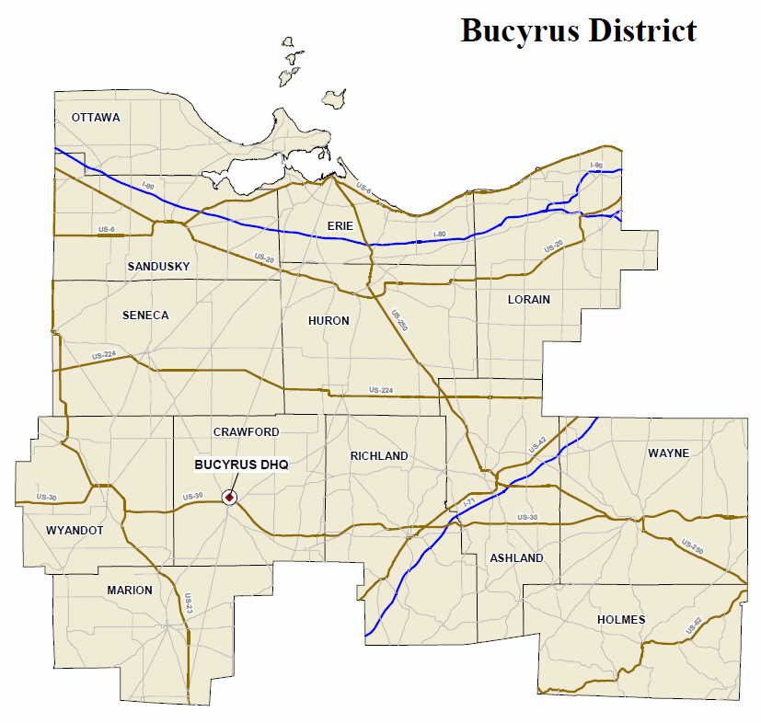
Contact Information – Bucyrus District
County | OSP Patrol Post
Ashland | Ashland
Crawford | Bucyrus
Erie | Sandusky
Holmes | Wooster
Huron | Norwalk
Lorain | Elyria
Marion | Marion
Ottawa | Sandusky
Richland | Mansfield
Sandusky | Fremont
Seneca | Fremont
Wayne | Wooster
Wyandot | Bucyrus
Contact Information:
OTSO Planner - Kelvin Williams: 614/466-3250
LEL - Frank Arvay: 419/213-0084
OSP Patrol Post: http://statepatrol.ohio.gov/Counties.stm

Slide 4
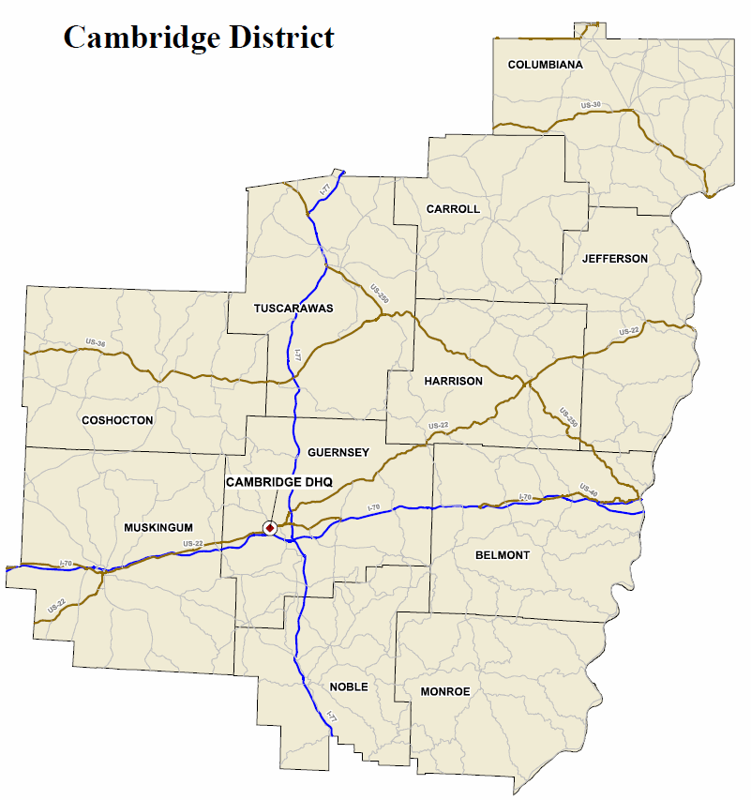
Contact Information – Cambridge District
Contact Information:
OTSO Planner - Michelle Liberati-Cobb: 614/466-3250
LEL - Rick Beverley: 330/697-1714
OSP Patrol Post: http://statepatrol.ohio.gov/Counties.stm
County | OSP Patrol Post
Belmont | St. Clairsville
Carroll | New Philadelphia
Columbiana | Lisbon
Coshocton | Zanesville
Guernsey | Cambridge
Harrison | Steubenville
Jefferson | Steubenville
Monroe | St. Clairsville
Muskingum | Zanesville
Noble | Cambridge
Tuscarawas | New Philadelphia

Slide 5
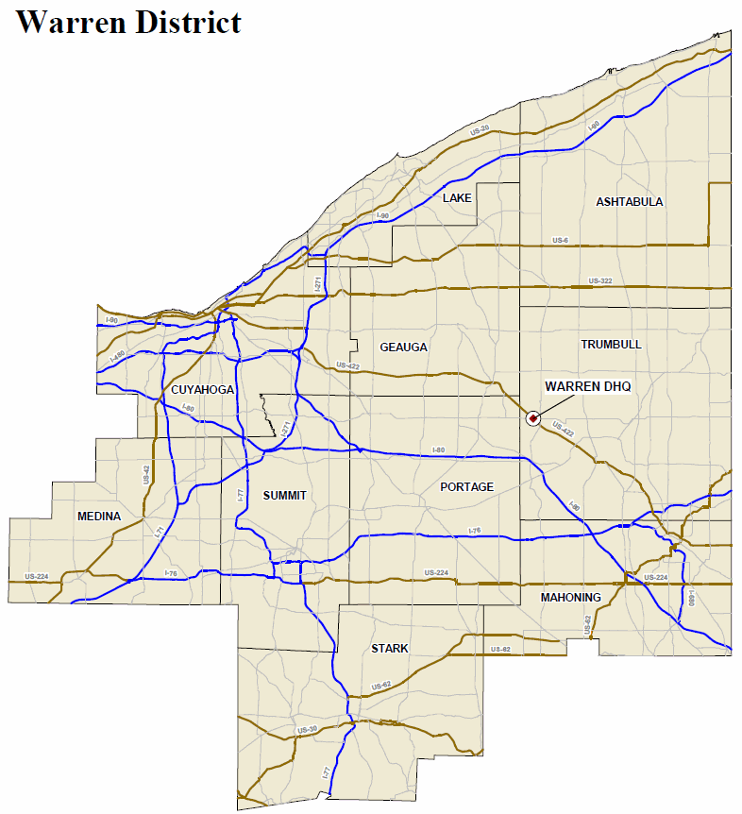
Contact Information – Cleveland District
Contact Information:
OTSO Planner - Michelle Liberati-Cobb: 614/466-3250
LEL - Rick Beverley: 330/697-1714
OSP Patrol Post: http://statepatrol.ohio.gov/Counties.stm
Cleveland District
County | OSP Patrol Post
Ashtabula | Ashtabula
Cuyahoga | Cleveland
Geauga | Chardon
Lake | Chardon
Mahoning | Canfield
Medina | Medina
Portage | Ravenna
Stark | Canton
Summit | Canton
Trumbull | Warren

Slide 6
Contact Information – Columbus District
County | OSP Patrol Post
Delaware | Delaware
Fairfield | Lancaster
Franklin | Columbus
Knox | Mt. Gilead
Licking | Granville
Madison | West Jefferson
Morrow | Mt. Gilead
Perry | Lancaster
Pickaway | Circleville
Contact Information:
OTSO Planner - Jackie Stephenson: 614/466-3250
LEL - Mike Brining: 614/946-2878
OSP Patrol Post: http://statepatrol.ohio.gov/Counties.stm

Slide 7
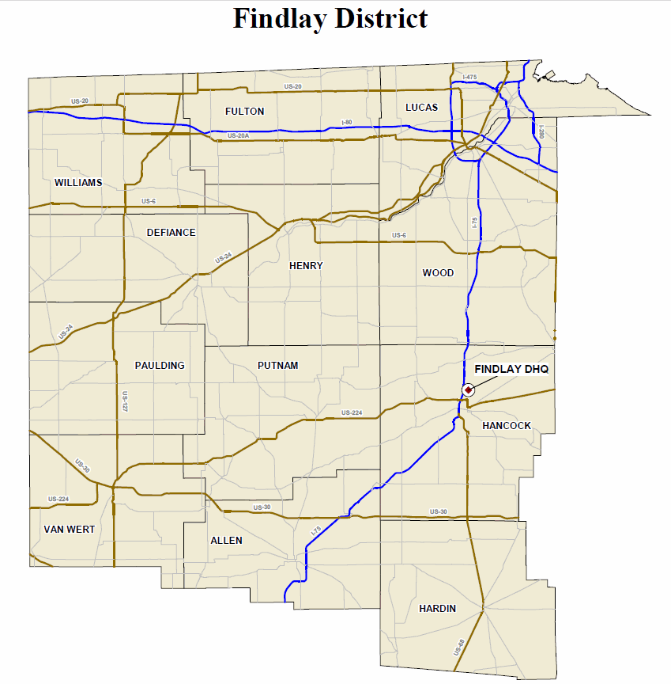
Contact Information – Findlay District
County | OSP Patrol Post
Allen | Lima
Defiance | Defiance
Fulton | Toledo
Hancock | Findlay
Hardin | Findlay
Henry | Bowling Green
Lucas | Toledo
Paulding | Van Wert
Putnam | Lima
Van Wert | Van Wert
Williams | Defiance
Wood | Bowling Green
Contact Information:
OTSO Planner - Kelvin Williams: 614/466-3250
LEL - Frank Arvay: 419/213-0084
OSP Patrol Post: http://statepatrol.ohio.gov/Counties.stm

Slide 8
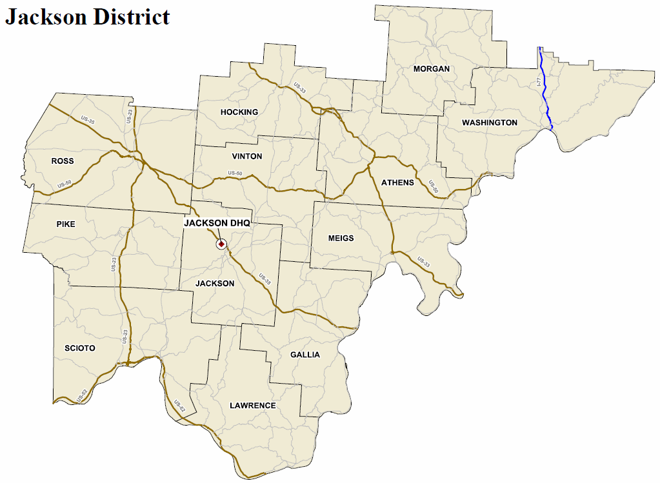
Contact Information – Jackson District
County | OSP Patrol Post
Athens | Athens
Gallia | Gallipolis
Hocking | Athens
Jackson | Jackson
Lawrence | Ironton
Meigs | Gallipolis
Morgan | Marietta
Pike | Chillicothe
Ross | Chillicothe
Scioto | Portsmouth
Vinton | Jackson
Washington | Marietta
Contact Information:
OTSO Planner - Jackie Stephenson: 614/466-3250
LEL - Mike Brining: 614/946-2878
OSP Patrol Post: http://statepatrol.ohio.gov/Counties.stm

Slide 9
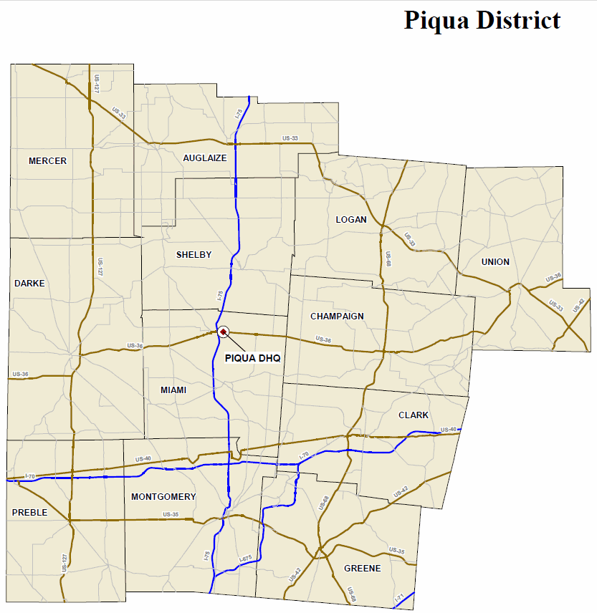
Contact Information – Piqua District
Contact Information:
OTSO Planner - Kelvin Williams: 614/466-3250
LEL - Chris Robertson: 513/518-8548
OSP Patrol Post: http://statepatrol.ohio.gov/Counties.stm
County | OSP Patrol Post
Auglaize | Wapakoneta
Champaign | Springfield
Clark | Springfield
Darke | Dayton
Greene | Xenia
Logan | Marysville
Mercer | Wapakoneta
Miami | Piqua
Montgomery | Dayton
Preble | Dayton
Shelby | Piqua
Union | Marysville

Slide 10
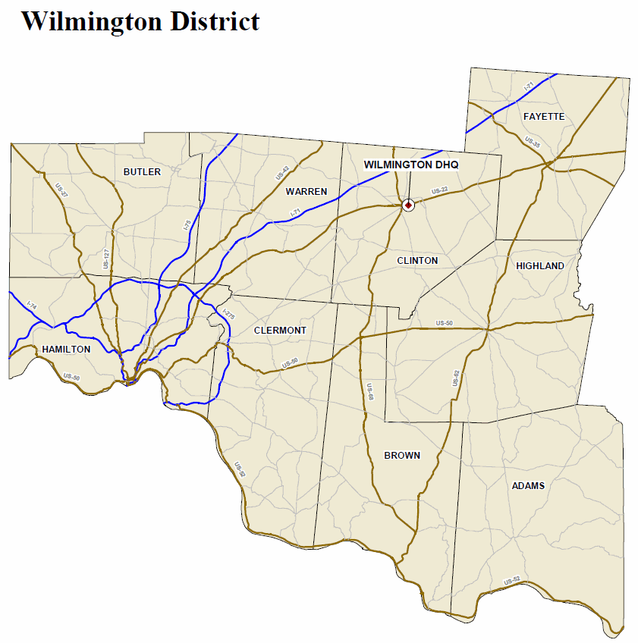
Contact Information – Wilmington District
County | OSP Patrol Post
Adams | Georgetown
Brown | Georgetown
Butler | Hamilton
Clermont | Batavia
Clinton | Wilmington
Fayette | Wilmington
Hamilton | Cincinnati
Highland | Wilmington
Warren | Lebanon
Contact Information:
OTSO Planner - Jackie Stephenson: 614/466-3250
LEL - Chris Robertson: 513/518-8548
OSP Patrol Post: http://statepatrol.ohio.gov/Counties.stm

Slide 11
Contact Information
Contact information may change throughout the year, OTSO will keep sub-grantees as up to date as possible.
These Contact Information slides will be updated as needed. Please refer back to these slides.

Slide 12
FFY 2015 Pre-Activity Form
Print the FFY 2015 Pre-Activity form from http://ohiohighwaysafetyoffice.ohio.gov
Use this form to follow along with this presentation.
Agency - enter your agency name.
Date – enter the date you are viewing this presentation.
County – enter the county where you are located.
Check the box to the left of General.
Reimbursement Claim schedule – check monthly or quarterly. New sub-grantees must check monthly.

Slide 13
Activity Dates
Beginning Date – Grant period will commence after this required pre-activity presentation has been completed and the authorized to proceed date listed in the Award Letter.
Ending Date – All grant activity must be completed by September 30, 2015.
Check the box next to beginning and ending dates on the Pre-Activity Form.

Slide 14
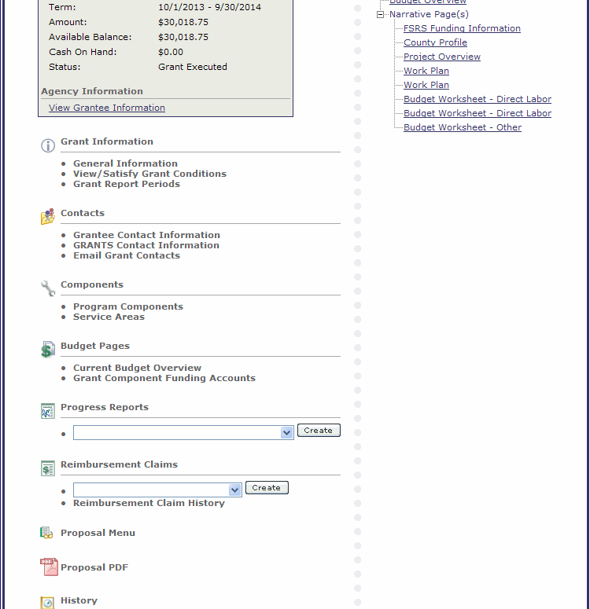
PDF
All sub-grantees need to generate a Full PDF of their grant outlining the goals, baselines, scopes of work, evaluations, work plans and the budget.
Click on Proposal PDF

Slide 15
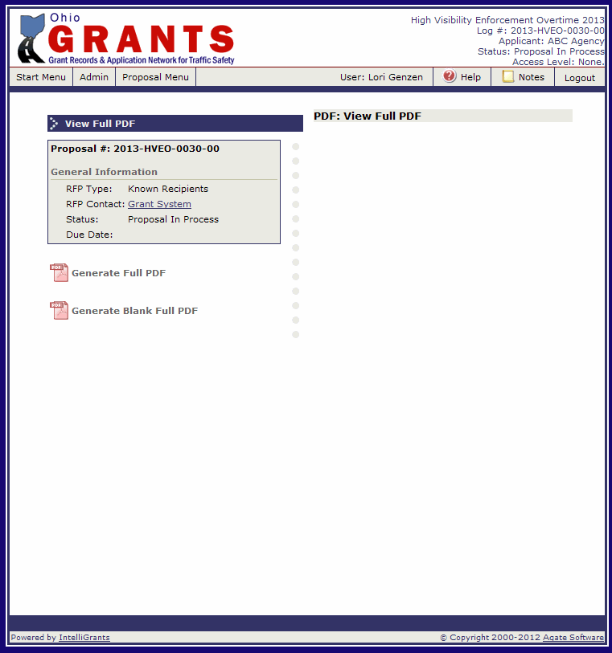
PDF
Click on Generate Full PDF.
This is an overnight process. The following morning you will receive an email stating that the PDF is ready. It will not be attached to the email.

Slide 16
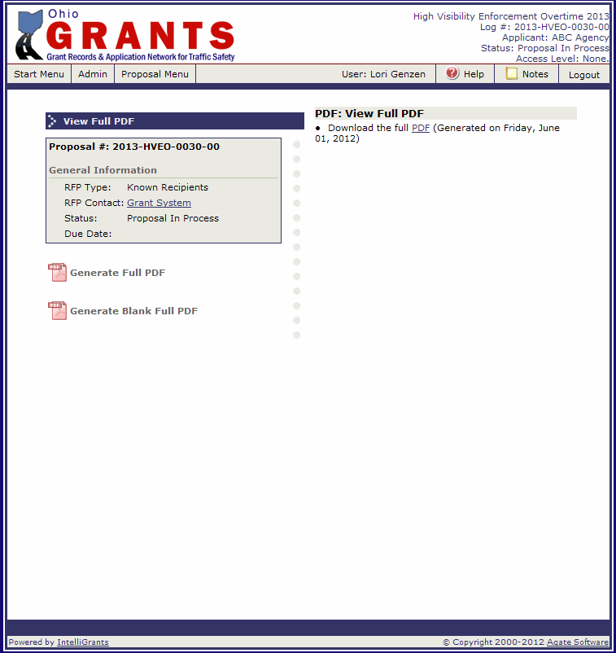
PDF
Return to this screen and click on the PDF on the right side.
Check the box next to Generate full PDF on the Pre-Activity form.

Slide 17
Mandatory National Mobilizations
Click It or Ticket: May 18 – May 31, 2015
Drive Sober or Get Pulled Over: August 21 – September 7, 2015
Check the box next to Mandatory National Mobilizations on the Pre-Activity form.

Slide 18
Allowable Costs
Personnel/Coordination Expenses (Salaries and Wages)
The sub-grantee needs to maintain a coordinator (project director) throughout the grant.
Public Information and Education (PI&E)
Meetings and Conferences
Travel
Keep your receipts
Receipts must be itemized
OTSO will not reimburse for meals provided by the conference.
Special diets and special needs have to be handled in advance with the conference.
Follow your agency’s Travel Policy.

Slide 19
Allowable Costs
Vehicle Mileage
Equipment
Supplies and Materials
Training
Contractual Services
Rate/Cost Allocation Charges
Refer to pages 71 – 73 of the Grant Solicitation Package for details on each cost category.

Slide 20
Unallowable Costs
Paid Advertising/Public Communications
Equipment
Certain Labor Costs
Alcoholic Beverages
Food
Vehicle Fuel
Entertainment
Lobbying
Office Furnishing & Fixtures
See pages 73 – 74 of the Grant Solicitation Package for details on each cost category.
Check the box next to allowable and unallowable costs on the Pre-Activity form.

Slide 21
Request to Purchase Form
Even if the item is approved in the grant, all purchases must be submitted to and approved by OTSO on a Request to Purchase form prior to incurring the cost.
Request to Purchase Forms should be submitted at least 45 days prior to the event.
A Request to Purchase form is required for:
Supplies
Materials
Incentives
Promotional Items
Educational Materials
Equipment
Training
Travel
Any questions about whether or not a form is required, contact OTSO.
Check the box next to Request to Purchase form on the Pre-Activity Form.

Slide 22
Grant Revisions
Any changes, additions, or deletions to this agreement must be submitted online and approved by OTSO prior to implementing proposed changes.
A reimbursement claim cannot be submitted while a revision is in process. You must wait until the revision is finalized (approved or rejected). If you have a claim in process and you submit a revision – the revision will be rejected.
All revisions must be submitted online to OTSO by September 1, 2015.
Check the box next to Grant Revisions on the Pre-Activity Form.

Slide 23
Terms and Conditions
The complete Terms and Conditions are on pages 10 – 25 of the FFY 2015 Grant Solicitation Package.
1) Agreement
Any inconsistencies between agreements and any attached documents shall be resolved in favor of the most current revised agreement on the online system, which shall be the controlling document.
8) Lobbying
None of the funds under this program will be used for any activity specifically designed to urge or influence a state or local legislator to favor or oppose the adoption of any specific legislative proposal pending before any state or local legislative body. Such activities include both direct and indirect (e.g., “grassroots”) lobbying activities.

Slide 24
Terms and Conditions
18) Press Release
Each sub-grantee is required to submit a press release to their local media announcing the grant award, including amount and purpose of award.
21) GRANTS User Accounts/Password Security
For security purposes, each person using the GRANTS system must have a separate user name and password. Each account must have its own email account. Sub-grantee agency personnel must not share passwords with agency staff or ODPS staff.

Slide 25
Terms and Conditions
22) Labor Costs
All work (personnel labor costs) reimbursed under this grant must be for actual hours worked. Labor costs based on a percentage of hours worked will not be accepted for reimbursement. Leave hours (e.g., sick, vacation, personal, holiday, etc.) are not reimbursable as direct labor. The employer’s share of fringe benefits (e.g., retirement, Workers’ Compensation, Medicare, etc.) are eligible for reimbursement. Documentation verifying fringe percentages must be available to OTSO upon request.
23) Personnel Activity Reports
Personnel activity reports may be required for any individual working on this federal grant program. These reports, at a minimum, must document date worked, actual activity performed and the number of hours per date to be charged to this agreement. This document must be signed by the individual and his/her immediate supervisor, maintained by the administering agency and submitted as a part of the reimbursement documentation required.

Slide 26
Terms and Conditions
24) Sub-Contracts
All sub-contracts and all purchases made under a sub-contract with any one vendor in excess of a combined total of $5,000 must be submitted to the OTSO for review prior to their execution and are subject to the same laws, regulations, and policies that govern this agreement. Contracts and procurements must include “Special Provisions” as provided by OTSO.
All supplies, materials, incentives, promotional items, education materials, and/or equipment that are purchased as a part of this sub-contract must be submitted to and approved by OTSO on a Request to Purchase form prior to incurring the cost.
Any training courses must be submitted to and approved by OTSO on a Request to Purchase form prior to scheduling.

Slide 27
Terms and Conditions
Supplies, materials, Incentives, Promotional Items,
Educational Materials
All supplies, materials, incentives, promotional items and educational materials must be used for approved traffic safety activities throughout its useful life. All purchases must be submitted to and approved by OTSO on a Request to Purchase form prior to incurring the cost. Outreach efforts should be made and materials should be provided to reach the ethnic and/or limited English speaking populations.
Alcohol is not allowed to be purchased with funds from this grant.
The sub-grantee must submit a final draft copy of all promotional materials to OTSO for approval prior to production. In addition:
All materials shall include federal sponsorship credit and/or disclaimer clauses as directed by OTSO.
All public service announcements funded with federal funds, in whole or in part, must be closed captioned for the hearing impaired.
All data results, reports, equipment, supplies and other materials (including but not limited to electronic versions) developed by the sub-grantee must be available to OTSO upon request.

Slide 28
Terms and Conditions
30) Travel
Any request for travel and associated costs must be submitted to and approved by OTSO on a Request to Purchase form prior to incurring any travel related costs.
Attendance at any conference/seminar/workshop that charges a registration fee must be submitted to and approved by OTSO on a Request to Purchase form prior to registration. All conferences/seminars/workshops must be traffic safety related; an agenda must be provided to OTSO.
A current travel policy must be submitted with the grant proposal. OTSO will not reimburse for meals provided by the conference. Alcohol is not allowed to be purchased with funds from this grant.

Slide 29
Terms and Conditions
31) Training
The cost of training personnel for traffic safety purposes may be funded when the training supports both the goals and scope of work of the approved grant program and the goals of OTSO. All training requests and purchases must be submitted to and approved by OTSO on a Request to Purchase form prior to incurring the cost.
33) Reimbursement Claims
This agreement will operate on a reimbursement basis only. The administering agency must first incur the costs for approved expenditures and then apply for the reimbursement. Appropriate and accurate documentation will be required for each expense. Claim schedules are set up either monthly or quarterly based on sub-grantees selection on the pre-activity form. Any changes from this schedule must be made by the sub-grantee in writing. Each sub-grantee must submit reimbursement claims by the due date assigned to the claim in the GRANTS System.

Slide 30
Terms and Conditions
35) Narrative Progress Reports
The timetable for submission of narrative progress reports will be determined by OTSO. Each sub-grantee must submit progress reports by the due date assigned to the report in the GRANTS system.
38) Final Report and Final Claim
A final comprehensive annual project activity report must be submitted to OTSO by November 1.
Final reports not received by November 1 will result in a 10 percent penalty deduction to the final claim reimbursement.
If a final project activity report is received after November 15, the final claim will not be reimbursed.
A properly documented final claim for reimbursement must be submitted to OTSO by November 1.
Final claims not received by November 1 will result in a 10 percent penalty deduction in the final claim reimbursement.
Final claims received after November 15 will not be reimbursed.

Slide 31
Terms and Conditions
39) Records Retention
All records relating to project activity and/or expenditures must be maintained for review by representatives of the federal or state government for at least three years following the final reimbursement payment.
41) Termination of Agreement
Either OTSO or the sub-grantee may terminate this Agreement for any reason by giving the other party 30 days written notice. If the Agreement is cancelled under this provision, OTSO shall reimburse the sub-grantee for approved work completed and documented to that date. Upon termination all data results, reports and other materials developed by the sub-grantee will become the property of OTSO. All of the equipment, materials and/or supplies provided to the sub-grantee for use under this agreement must be returned to OTSO upon request within 30 days of said written notice. Should any change in federal funding adversely affect OTSO’s ability to complete the fiscal year’s activities, OTSO has the right to revise or terminate the agreement in writing.

Slide 32
Terms and Conditions
62) Personnel Activity Reports
Personnel activity reports are required for all individuals working on this federal grant program. These reports, at a minimum, must document date worked, actual activity performed and the number of hours per day to be charged to this agreement. This document is to be signed by the individual and his/her immediate supervisor. It must be included as a part of the reimbursement documentation.
Check the box next to Terms and Conditions on the Pre-Activity form.

Slide 33
General Grant
GRANTS System
Report, Reimbursement Claim and Revision Process

Slide 34
Progress Report
OTSO will assign reports based on the type of activity. Some general grants will have monthly narrative progress reports and some will have quarterly narrative progress reports.
Monthly reports are due the 15th of the following month (Ex: report for October activity will be due November 15th). Quarterly reports will be due the 15th of the month following the end of the quarter. (Ex: The first quarter (October – December) is due January 15th).

Slide 35
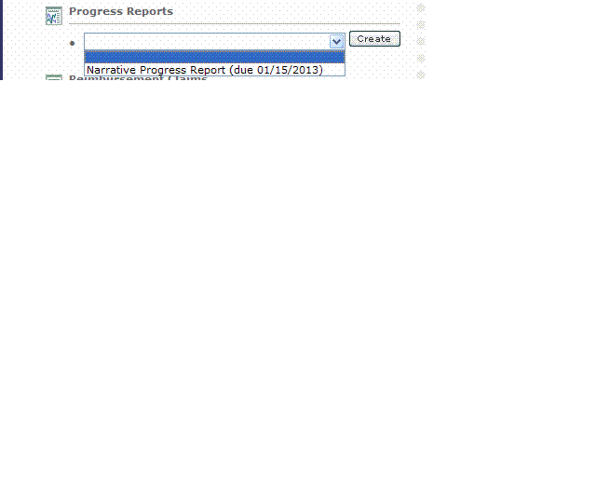
Narrative Progress Reports
Progress reports will be listed in the drop down under Progress Reports.
Reports will be in the drop down
the first day of the reporting
period. (Ex. May Report will be in the
drop down May 1st).
The date listed after the report name is the date the report is due. If a report is past due, you will not be able to submit a claim (or re-submit a claim that was sent back for modifications).
1
2

Slide 36
Narrative Progress Reports
To initiate the report:
Select the report from the drop down menu.
2. Click the “Create” button.
1
2

Slide 37
Narrative Progress Report Menu
General Information Box lists the report title, the current status of the report, the due date of the report and the period that this report covers.
Final Report: Default is “no”. This is correct until the last monthly narrative progress report (September). If you tell the system “yes”, the system will not generate additional monthly narrative progress reports.
Grant Report Forms: List of all forms in the Narrative Progress Report.
2
1
3

Slide 38
Narrative Progress Report
Click on the first Goal Progress to begin filling out the forms.
You will have a Goal Progress page for each goal you submitted in the grant.

Slide 39
Goal Progress
The report pulls forward your goal, baseline and evaluation from your grant.
Using your evaluation as a guide, enter the current status of the goal. Example: If your evaluation was “Number of people reached, number and types of materials distributed, number of news releases issued and media coverage received” your current status would read “This month we reached 5,432 people; distributed 500 impaired driving posters, 300 distracted driving posters, 1,000 Click It or Ticket magnets; issued 3 media releases and the media covered 1 event.
Click “Save”.
If you have additional goals, use the drop down and go buttons or the small next to proceed to the next page.
After completing the last goal result, click “Next”.
3
4
2
1

Slide 40
Other Grant Related Information
7
8
Enter any accomplishment during this reporting period.
Enter any training conducted during this reporting period.
Enter any Public Information & Education efforts during this reporting period.
Enter any partnerships made this month.
Enter any challenges that occurred this reporting period.
Enter any legislation during this reporting period.
Click “Save”.
Click “Next”.
Note: If there was no activity in any of these fields for the reporting period, enter none or n/a.
1
2
3
4
5
6

Slide 41
Meeting Form
Use this form to report any meetings conducted during the month. This form may not be assigned to all grants.
If no meetings were conducted, check the “No Activity” box.
Select Meeting Type from drop down.
Enter the meeting name.
Enter the date of the meeting.
Enter the number of people who attended the meeting.
Enter the purpose of the meeting.
Enter the accomplishments of the meeting.
Click “Save”.
8
1
2
3
4
5
6
7

Slide 42
Meeting Form
After hitting save, allow the page to process.
If you need to enter another form, hit “Add” and repeat steps 1 - 8 on the previous slide.
Once you are done entering meetings, click “Next”.
1
2

Slide 43
Event/Activity Form
You must complete an Event/Activity form for each event or activity completed during the month. Do not complete a form for meetings, work on a project (Ex. In October you spent time planning an event/activity that is going to take place in December – the planning is not an event/activity. You only complete a form for the actual event/activity). This form may not be assigned to all grants.
If no events/activities were conducted this month, check the “No Activity” box.
Select whether the event/activity is grant funded or in-kind. If the grant is paying for any part of the event/activity (labor hours, supplies, etc.) select grant funded. If the grant isn’t paying for any part, select in-kind.
Enter the name of the event/activity.
Enter the date of the event/activity.
Enter the location of the event/activity.
Enter the number of people reached.
Enter the population reached (hispanic, teens, adults, etc.)
Check the box or boxes that describe the focus of the event/activity. If you select “other”, you must describe what the focus is in the box provided.
Enter the branded message or messages that were used.
Continued on next slide.
1
2
3
4
5
6
7
8
9

Slide 44
Event/Activity Form, cont.
Check the box or boxes that describe how you promoted the event/activity prior to day of the event/activity. If you select “other”, you must describe how in the box provided.
Check the box or boxes that describe how you promoted during the event/activity. If you select “other”, you must describe how in the box provided.
Check the box or boxes that describe what was done at the event/activity. If you select “other”, you must describe what else was done in the box provided.
Answer whether or not there were any monetary donations contributed to this event/activity.
Continued on next slide.
1
2
3
4

Slide 45
Event/Activity Form, cont.
If monetary donations were received, enter the donating agency and the amount of the contribution. If you enter an agency name, you must enter a contribution.
Answer whether or not donations (other than monetary) were made to the event/activity.
If other donations were made, list the agency and the donation. If you enter an agency name, you must enter a donation. If you received the same items (ex. prizes) from multiple agencies, you can list multiple agency names on one line item and list prizes under donation.
List the number of volunteer hours that were contributed to the event.
Enter the gross impressions for each type of media coverage the event/activity received. Gross impressions for newspapers is the circulations, radio is the listenership, television is the viewership, web is the number of hits. If you check “Other”, list the gross impressions and list what type of media it is.
Enter any highlights of the event/activity.
Click “Save”.
1
2
3
4
5
6
7

Slide 46
Event/Activity Form, cont.
After hitting save, allow the page to process.
If you need to enter another event/activity, hit “Add” and repeat the steps on the previous three slides.
Once you are done entering events/activities, click “Next”.
1
2

Slide 47
Progress Report Attachments
Use this form to attach documents to your monthly narrative progress report (press releases, news articles, etc.). Do not attach claim related documentation to your report.
Give a brief description of the document.
Click “Browse” to search your computer for the file.
Click “Save”.
Click “Add” and repeat steps 1 – 3 to add additional attachments.
When done adding attachments, click “Report Menu”.
NOTE: When attaching PDFs, make sure the file name does NOT include any special characters (&, #, %, etc.)
5
4
3
1
2

Slide 48
Narrative Progress Report Menu
When you are certain all data has been entered accurately and completely, click “Check Errors” to see if there are any system errors to fix prior to submitting.
If you would like a PDF of the report to print or save to your computer, click “Generate Full PDF”.
If there are no errors, click the “Submit” button.
3
1
2

Slide 49
Report Submitted
Once your report is successfully submitted, you will see a confirmation at the top of the screen and the status will change in the General Information box.
Click “Grant Menu” to return to the Grant.

Slide 50
Annual Report
A final comprehensive annual project activity report must be submitted to OTSO by November 1.
Final reports not received by November 1 will result in a 10 percent penalty deduction to the final claim reimbursement.
If a final project activity report is received after November 15, the final claim will not be reimbursed.
The annual report will be available in the GRANTS System by August 31, 2015.

Slide 51
Annual Report
To initiate the report:
Select the report from the drop down menu.
Click the “Create” button.
2
1

Slide 52
Annual Report Menu
General Information Box lists the report title, the current status of the report, the due date of the report and the period that this report covers.
Final Report: Default is “no”. Change to “Yes”.
Grant Report Forms: List of all forms in the Annual Report.
2
1
3

Slide 53
Annual Report Menu
Click on the first Goal Results to begin filling out the forms.
You will have a Goal Results page for each goal you submitted in your grant.

Slide 54
Goal Results
The report pulls forward your goal, baseline and evaluation from your grant.
Using your evaluation as a guide, enter the current status of the goal. Example: If your evaluation was “Number of people reached, number and types of materials distributed, number of news releases issued and media coverage received” your current status would read “This year we reached 25,432 people; distributed 1,500 impaired driving posters, 1,300 distracted driving posters, 1,000 Click It or Ticket magnets; issued 13 media releases and the media covered 8 events.
Click “Save”.
If you have additional goals, use the drop down and go buttons or the small next to proceed to the next page.
After completing the last goal result, click “Next”.
3
4
2
End Result Vs. Goal
1

Slide 55
Other Grant Related Information
Describe any partnerships made during the grant year.
List any other funding or in-kind resources that were obtained during the grant year.
Describe any challenges during the grant year and how they were resolved.
Describe any highlights or noteworthy activities that happened during the grant year.
Click “Save”.
After the page has been saved, click “Report Menu”.
6
5
1
2
3
4

Slide 56
Annual Report Menu
When you are certain all data has been entered accurately and completely, click “Check Errors” to see if there are any system errors to fix prior to submitting.
If you would like a PDF of the report to print or save to your computer, click “Generate Full PDF”.
If there are no errors, click the “Submit” button.
3
1
2

Slide 57
Report Submitted
Once your report is successfully submitted, you will see a confirmation at the top of the screen and the status will change in the General Information box.
Click “Grant Menu” to return to the Grant.

Slide 58
Report Submitted Process
Once the report has been submitted to our office, it goes through a review process.
The report will be under “Progress Report Submitted” until the review is complete.
If it is approved, it will be under “Progress Report Approved”.
If it is sent back for modifications, you will receive an email and it will be under “Progress Report Modification Required”.
Log into the GRANTS System to make the modifications.
Note: If you do not receive the email, check your email address in the GRANTS System (update if needed) or check with your agency IT Administrator to see if our system generated emails from otso@dps.state.oh.us are being blocked as spam.

Slide 59
Report Modifications
On the Start Menu, under the Task List, any items that need modifications will be listed.
Click on the link for the report you want to modify.
1
2

Slide 60
Report Modification
Modifications that are required will be listed on the Report Menu outlined in a red box.
Complete the changes, return to the Report Menu and click “Submit” to re-submit the report.
Check the box next to Report Process on the Pre-Activity Form.
2
1

Slide 61
Reimbursement Claim Process
Reimbursement claims will be due either the 15th of the following month for monthly claims (Example: October claim will be due November 15th) or the 15th of the month following the end of the quarter (Example: First quarter claim (October – December) will be due January 15th).
Verify your claim schedule selection on the Pre-Activity Form. New sub-grantees must select monthly.
Reimbursement claims can include previous activity but cannot go beyond the current claim period. (Example: The December claim can include a November expense, but not a January expense).
If there is no activity, you must submit a zero claim.

Slide 62
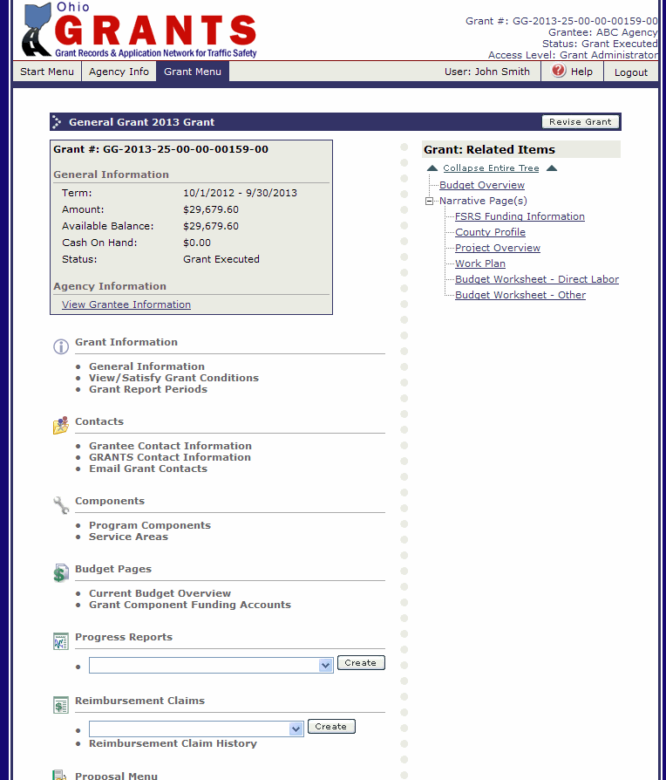
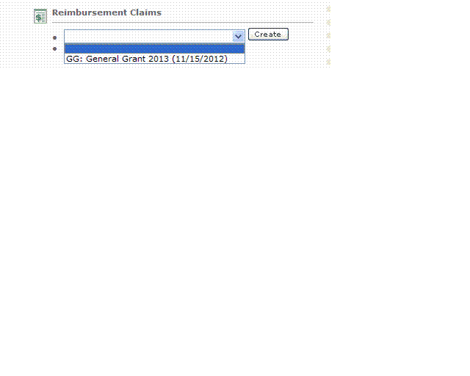
Reimbursement Claim Process
Reimbursement Claims will be listed in the drop down under Reimbursement Claims.
Claims will be in the drop down the first day of the claim period. (Ex. May Claim will be in the drop down May 1st).
The date listed is the date the claim is due. If a progress report is past due, you will not be able to submit a claim (or re-submit a claim that was sent back for modifications).
Only one claim can be processed at a time. The next claim will not show up in the drop down until the previous one has been approved.
2
1

Slide 63
Reimbursement Claim Process
To initiate the reimbursement claim:
Select the claim from the drop down menu.
2. Click the “Create” button.
1
2

Slide 64
Reimbursement Claim Process
The Expense Summary Page shows grant information.
Budget Information
Previous Expenses will show after the first claim has been approved.
Budget Remaining (Award – Previous Claim)
Current Period Expenses (once you add Expense Detail items these fields will self-populate).
Every time a subsequent claim is initiated, the previous expenses and budget remaining will update to include all previous approved claims.
6. Click the “Edit” button.
6
1
2
3
4
5

Slide 65
Reimbursement Claim Process
Unless it is the final claim for the year, select “No” for Final Report. If you select “Yes” the system will not issue any more Reimbursement Claims.
Enter the reporting period. Typically it would be the beginning of the month (or quarter) to the end of the month (or quarter). However, if you need to claim an expense from a previous reporting period you will need to make the beginning date the date of the earliest expense. (Ex. November claim would normally be 11/1/2014 to 11/30/2014. If you have an invoice from 10/17/2014 to claim, the reporting periods would be 10/17/2014 to 11/30/2014).
Comments – If you have any comments/notes you would like the OTSO review team to see regarding your reimbursement claim, enter them here.
Click the “Save” button.
Click the “Expense Detail” tab.
5
4
1
3
2

Slide 66
Reimbursement Claim Process
Use this screen to enter each expense for the reimbursement claim. The fields required for each expense will change based on the budget category selected.
Select the budget category from the drop down. Make sure you are putting the expense in the appropriate category. (Ex. If you received approval to purchase an item using the Supplies and Materials category, select that category here. Do not select another category).
Wait for the page to refresh.

Slide 67
Reimbursement Claim Process
Direct Labor
Item: Not required
Budget Column: Select from the drop down. This will show how much you have remaining in this budget category.
Name/Title – Enter the Employee’s Name and Title.
Begin Date/End Date – Enter the beginning date and ending dates of the labor that is being claimed.
Activity Description – Enter the activity description, or enter “See Personnel Activity Report”.
Check Number – Enter either a check number if the person was paid with a check, or enter DD or EFT if the person was paid with Direct Deposit.
Enter the number of hours for that date range.
Enter the hourly rate that the employee was paid, not the rate entered in the proposal.
Click the “Save” button.
NOTE: OTSO only pays for OT that has been paid out to the employee. Comp Time is not allowable.
9
1
2
3
4
5
6
7
8

Slide 68
Reimbursement Claim Process
Once saved, the information will self-calculate and appear below the Add an Expense Item Box. As you continue to add expenses, they will continue to appear at the bottom.
Select another budget category from the drop down and wait for the page to refresh to continue adding line items to the reimbursement claim.
1

Slide 69
Reimbursement Claim Process
Labor Fringe Benefits
Item: Not required
Budget Column: Select from the drop down. This will show how much you have remaining in this budget category.
Date Worked/End Date – Enter the date range to cover the direct labor worked in the claim.
Description – enter “Fringe”
Fringe Calculation – enter the amount of fringe you are claiming.
Click the “Save” button.
Note: Make sure you are claiming the actual amount of fringe that is being paid. Ex: If Worker’s Comp was 2.4% when you submitted the proposal and your agency is actually paying 1.7%, you can only claim 1.7%.
6
1
2
3
4
5
Note: You cannot claim a higher percentage than you have been approved for in the grant. Ex: If you were approved for 21.75%, you cannot claim 24.5% without having a revision approved. You can claim less than you were approved for.

Slide 70
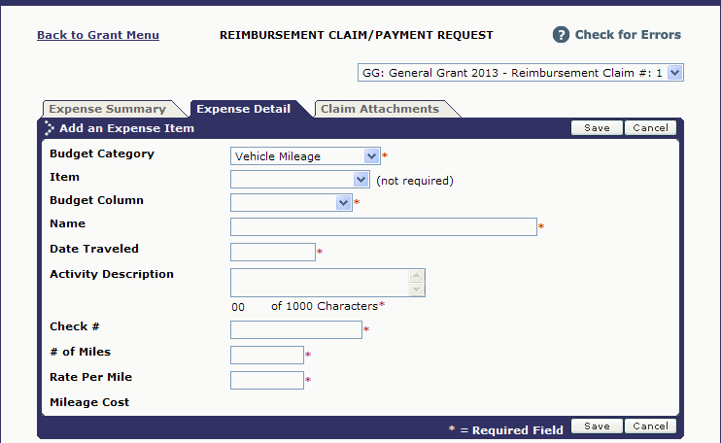
Reimbursement Claim Process
Vehicle Mileage
Item: Not required.
Budget Column: Select from the drop down. This will show how much you have remaining in this budget category.
Name – Enter the name of the employee that claimed the mileage.
Date Traveled – Enter the date the travel occurred.
Activity Description – Enter the description of where/why the employee traveled or enter “See Mileage Log”.
9
1
2
3
4
5
6
7
8
Check # - Enter the check number issued to reimburse the employee.
# of Miles – Enter the number of miles the employee traveled.
Rate per Mile – Enter the rate per mile reimbursed to the employee.
Click the “Save” button.
Make sure you are not claiming a higher rate than you have been approved for in the grant. If you were approved for $0.50 per mile, you are not allowed to claim $0.55 per mile without having a revision approved. You are allowed to claim less that you were approved for.

Slide 71
Reimbursement Claim Process
Other Direct Costs
Item: Not required, however if you have different line items in this budget category, select the correct line item.
Budget Column: Select from the drop down. This will show how much you have remaining in this budget category.
Name/Description – Enter the name and a description of the item.
7
1
2
3
4
5
6
4. Enter the invoice date for the item.
5. Enter the Check or Warrant number used to pay for the item.
6. Enter the cost of the item.
7. Click the “Save” button.

Slide 72
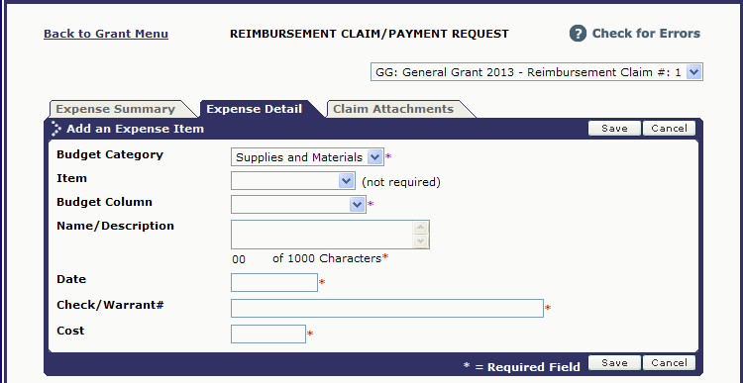
Reimbursement Claim Process
Supplies and Materials
Item: Not required, however if you have different line items in this budget category, select the correct line item.
Budget Column: Select from the drop down. This will show how much you have remaining in this budget category.
Name/Description – Enter the name and a description of the item.
7
1
2
3
4
5
6
Enter the invoice date for the item.
Enter the Check or Warrant number used to pay for the item.
Enter the cost of the item.
Click the “Save” button.

Slide 73
Reimbursement Claim Process
Contractual Services
Item: Not required, however if you have different line items in this budget category, select the correct line item.
Budget Column: Select from the drop down. This will show how much you have remaining in the budget category.
Name/Description – Enter the name and a description of the item.
Enter the activity date for the item. If the activity dates span a month period, put the last day of the month
7
1
2
3
4
5
6
5. Enter the Check or Warrant number used to pay for the item.
6. Enter the cost of the item.
7. Click the “Save” button.

Slide 74
Reimbursement Claim Process
Travel Expense
Item: Not required, however if you have different line items in this budget category, select the correct line item.
Budget Column: Select from the drop down. This will show how much you have remaining in the budget category.
6
1
2
3
4
5
Date – Enter the invoice date for invoiced items (airline tickets, registration, etc.). Enter the last travel date for other travel expenses (hotel, meals, parking, etc.). Each expense type needs to be listed separately.
Description – Enter a description of the expenses.
Amount – Enter the amount.
Click the “Save” button.

Slide 75
Reimbursement Claim Process
Once all entries have been made, review for accuracy.
If you find an expense line that has an error:
Click the radio button next to the item that needs correction.
If the entire line needs deleted (duplicate entry), click “Delete”.
If you just need to make changes, click “Edit”.
3
2
1

Slide 76
Reimbursement Claim Process
After you click edit, the top box will populate with the information previously entered.
Make the necessary changes and click the “Save” button.
When you are certain all expenses have been entered accurately and completely, click the “Expense Summary” tab.
2
1

Slide 77
Reimbursement Claim Process
If you need to attach documentation to support charges in the reimbursement claim (invoices, personal activity reports, travel receipts, etc.), click the “Claim Attachments” tab.

Slide 78
Reimbursement Claim Process
Click “Add”.

Slide 79
Reimbursement Claim Process
Enter the title of the attachment. (Example: Travel Receipts)
Click “Browse” to locate the file on your computer.
Once the document is showing in the file path, click “Save”.
NOTE: When attaching PDFs, make sure the file name does NOT include any special characters (&, #, %, etc.)
3
1
2

Slide 80
Reimbursement Claim Process
If you need to attach additional documentation, click “Add” and follow steps 1 – 3 on the previous slide.
Once you have attached all documentation, click “Back to Claim”
2
1

Slide 81
Reimbursement Claim Process
The Current Period Expenses have now been totaled from the entries.
Click “Check for Errors” to see if there are any system errors to fix prior to submitting.
If there are no errors, click the “Submit” button.
Reminders:
You cannot submit a reimbursement claim if you have progress reports that are past due.
You cannot submit a reimbursement claim until the costs have been paid.
You will be asked to enter your password.
1
2

Slide 82
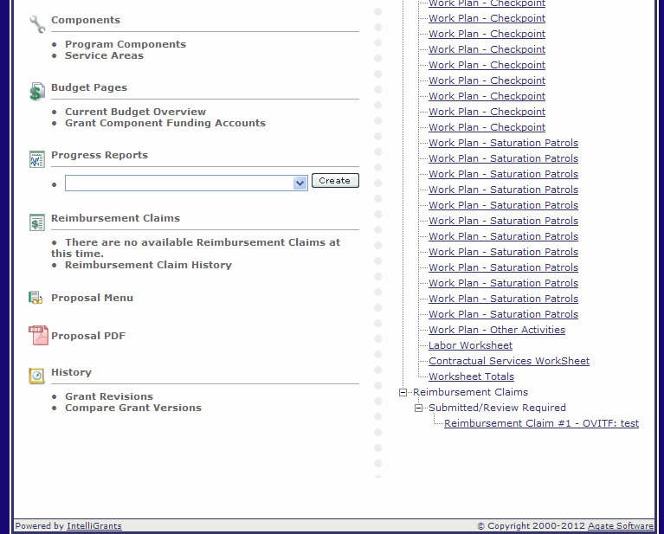
Reimbursement Claim Process
Once the claim has been submitted to our office, it goes through a review process.
The claim will be under “Submitted/Review Required” until the review is complete.
If it is approved, it will be under “Approved”. OTSO normally processes payments weekly (holiday weeks may alter schedule).
Once the claim has been processed for payment, it will be under “Payment Initiated”.
Payment should be received 2 – 3 weeks after they have been marked “Payment Initiated”.
When the check is sent, the claim will be under “Payment Complete”. If you receive a paper check, this means it was put in the mail. If you receive EFT, payment should be in your account.

Slide 83
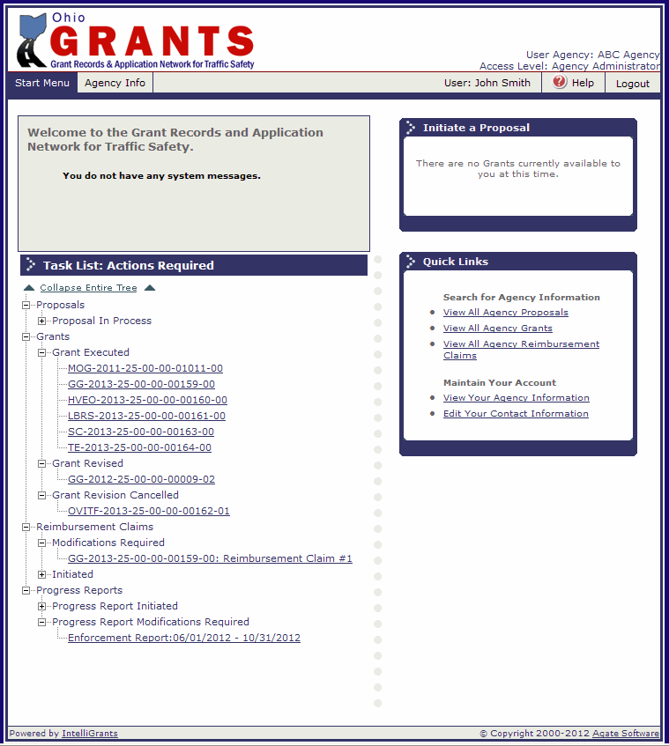
Reimbursement Claim Process
If your claim is not approved, it will be under “Modifications Required” and you will receive an e-mail letting you know it has been returned.
Return to the GRANTS System and the claim will be under your task list.
Note: If you do not receive the email, check your email address in the GRANTS System (update if needed or check with your agency IT Administrator to see if our system generated emails from otso@dps.state.oh.us are being blocked as spam.

Slide 84
Reimbursement Claim Modification
Modifications that are required will be listed on the Expense Summary outlined in a red box.
Click on Expense Detail to make the corrections.
Note: There are limited characters available, check with your planner if the comment is not complete.

Slide 85
Expense Detail Modifications
The Comments are still at the top of the screen for reference.
Find the line item you need to correct, select the radio button.
To make changes to the entry, click “Edit”.
To delete the entry, click “Delete”.
1
3
4
2

Slide 86
Expense Detail Modifications
The top box will populate with the information previously entered.
Make the corrections in the top box.
Click “Save”.
To make corrections on the claim attachment page, click “Claim Attachments” tab.
If all corrections are complete, click “Expense Summary”.
4
3
5
1
2

Slide 87
Claim Attachment Modifications
To modify the current attachment, check the box next to the attachment.
To delete, click “Delete”.
To edit, click “Edit”.
To add additional files, click “Add”.

Slide 88
Claim Attachment Edit
Change the title, or
Attach an updated file by clicking “Browse”.
Click “Save”.
3
1
2

Slide 89
Claim Attachment Add
Enter the title.
Click “Browse” to locate the file on your computer.
Click “Save”.
3
1
2

Slide 90
Claim Attachment Modification
When done deleting, editing and adding attachments, click “Back to Claim”.

Slide 91
Reimbursement Claim Modifications
Verify that all the corrections mentioned in the Review Comments have been made. If they have, click “Submit”.

Slide 92
Electronic Reimbursement
Reimbursement can be received electronically by going to :
http://ohiosharedservices.ohio.gov/Vendors.aspx
Check the box next to Reimbursement Claim Process on the Pre-Activity Form.

Slide 93
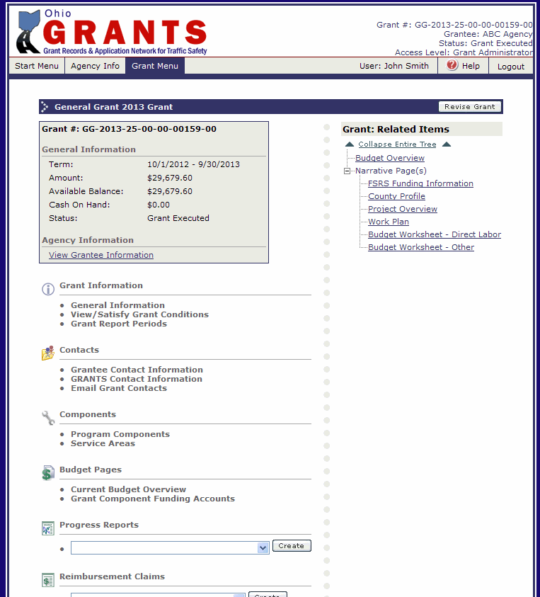
Revision Process
All grant revisions must be submitted by September 1, 2015.
To initiate a revision, click “Revise Grant”.

Slide 94
Grant Revision
Once you click “Revise Grant”, you will receive this warning message:
Once a revision has been initiated do not initiate a new reimbursement claim, and any initiated reimbursement claims including modifications cannot be submitted until the revision has been fully approved.

Slide 95
Grant Revision
The Budget Overview page has the Justification. All changes you are making to the grant need to be listed in this box. Ex: Moved 20 hours from Christmas to St. Patrick’s Day. Moved $1,500.00 from Supplies and Materials to Other Direct Costs.
If you need to wait until you have made your changes to fill this in, make sure you return to this page when you enter the justification. (It is the only time the “Save” button will appear).

Slide 96
Narrative Page Revisions
To make changes to any Narrative Page (Applicant Assurances, Project Overviews (Goals), Work Plans, Budget Worksheet – Direct Labor, Budget Worksheet – Other), click “Narrative Pages” tab.

Slide 97
Narrative Page Revisions
Select the page you want to revise in the drop down and click “go”.
Once it pulls up the information from the grant, you will see the information in two boxes. The bottom box is what was in the grant previously.
Make changes in the top box.
Click “Save”.
1
3
2

Slide 98
Narrative Page Revisions
To select another Narrative Page, choose the name and click “go”.
If that page has multiple pages, select the one from the drop down and click “go” or click “next” to scroll through.
Again, make changes in the top box.
Click “Save”.
If you need to add a new page, click “add”.
2
1
3
5
4

Slide 99
Narrative Page Revisions
After you click “Add”, a blank form will come up. Complete and click “Save” just like on the proposal.
Note: There will not be a bottom box for new pages, there was no previous page to compare it to.

Slide 100
Narrative Page Revisions
If the only revisions that were needed were on narrative pages and you have completed the Justification Box, click “Submit Revisions”.
If you need to make revisions in the budget or still need to complete the Justification box, click the “Budget” tab.
1
2

Slide 101
Grant Revision
If you need to make revisions in the budget, click on the link under budget overview.
If the only revisions that were needed were on narrative pages, complete the Justification Box.
Click “Save”.
Click “Check for Errors” to see if there are any system errors to fix prior to submitting.
Click “Submit Revisions”.
5
4
2
3
1

Slide 102
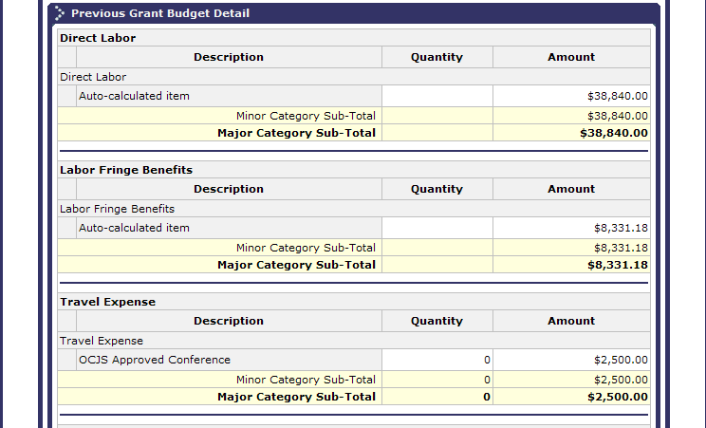
Budget Revisions
Top
2
Once it pulls up the information from the grant, you will see the information in two boxes. The bottom box is what was in the grant previously. Changes must be made in the top box.
To make changes to the line item amount only:
Check the box next to the line item.
Click “Edit”.
1
Bottom

Slide 103
Budget Revisions
Change the amount.
Click “Save”.
2
1

Slide 104
Budget Revisions
To revise the budget amount and the description:
Click the link for the line item.

Slide 105
Budget Revisions
Make the changes in the description and/or the amount.
Click “Save”.
After saving, click “Budget Detail” to return to the budget.
3
2
1

Slide 106
Budget Revisions
To add a new item in the budget:
Click “Add Budget Item”.

Slide 107
Budget Revisions
Select the Budget Category from the drop down.
Enter a short description on this line (the title of the item).
Enter a more detailed description.
Enter a quantity if applicable.
Enter the amount.
Click “Save”.
Continue adding additional items, until all new items have been added.
Click “Budget Detail” to return to the Budget.
7
6
1
2
3
4
5

Slide 108
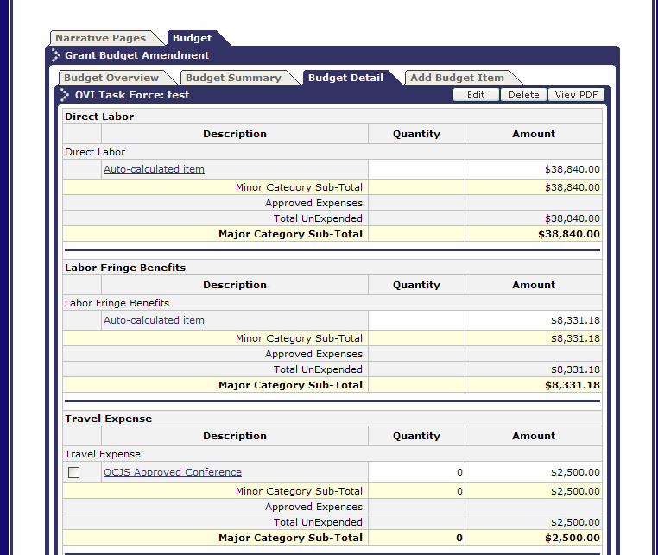
Budget Revisions
On the Budget Detail Page, review all line items on the top section to ensure all changes have been made. When done, click “Budget Overview”.

Slide 109
Grant Revisions
Complete the Justification Box. Make sure all changes (both narrative and budget are listed in the justification).
Click “Save”.
Compare the Budget Overview to the Previous Budget Overview to ensure that the budget has not increased (unless you have prior approval to increase your budget) or decreased (unless you wish to decrease the budget).
Click “Check for Errors” to see if there are any system errors to fix prior to submitting.
Click “Submit Revisions”.
5
4
1
2
3

Slide 110
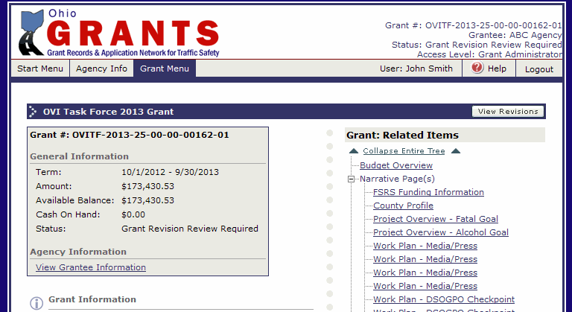
Grant Revisions
Once the revision has been submitted to our office, it goes through a review process.
The grant will be under “Grant Revision Review Required” until the review is complete.
If it is approved, the grant status will update to “Grant Revised”.

Slide 111
Grant Revision Modifications Required
If your revision is not approved, it will be under “Grant Revision Modifications Required” and you will receive an e-mail letting you know it has been returned.
Return to the GRANTS System and the claim will be under your task list. Click on the link.
Note: If you do not receive the email, check your email address in the GRANTS System (update if needed) or check with your agency IT Administrator to see if our system generated emails from otso@dps.state.oh.us are being blocked as spam.

Slide 112
Grant Revision Modifications Required
From the Grant Menu, click on “View Revisions”.

Slide 113
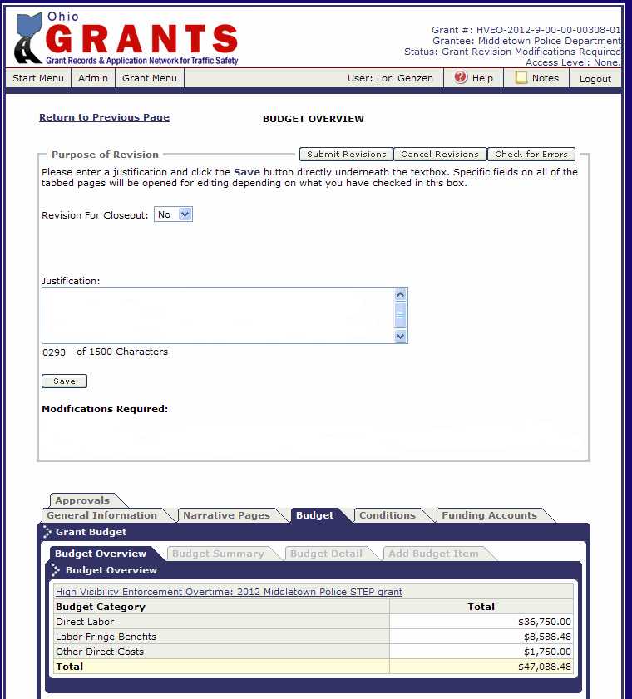
Grant Revision Modifications Required
Modifications that are required will be listed on the Budget Overview under Modifications Required.
Follow the steps on slides 95 – 109 to make the required changes and re-submit the revision.
Check the box next to Revision Process on the Pre-Activity form.

Slide 114
Controlling Access to Grant
To change/add personnel to the grant:
Click “Grantee Contact Information”.

Slide 115
Controlling Access to Grant
The people who were added to the proposal are automatically transferred to the grant.
If you need to make changes to the existing contact type or level of access:
Click the radio button next to the name.
Click the “Edit” button and make the necessary changes.
2
1

Slide 116
Controlling Access to Grant
Make the change to either the Contact Type or the Level of Access.
Contact Types
Authorizing Official – The authorizing official is usually the head of an organization/agency. This individual must possess or have the ability to obtain the legislative authority to enter into an agreement with OTSO.
Project Director – The project director is designated as the agency’s liaison with OTSO by the authorizing official. This individual will oversee the daily activities of the grant and ensure that the scope of work, evaluation and work plans are completed as proposed. This individual will also serve as the primary contact person for the grant.
Fiscal Officer – The fiscal officer is responsible for the fiscal activities of the agency. This individual is responsible for overseeing the grant’s budget, as well as submitting properly prepared claims for reimbursement to OTSO.
Level of Access
Grant Administrator – has access to make changes, submit reports and reimbursement claims.
Viewer – Can only view the grant.
Click “Save”.
2
1

Slide 117
Controlling Access to Grant
If you need to delete an existing contact from the grant:
Click the radio button next to the name.
Click the “Delete” button.
This will only remove the person’s access to this grant. It does not remove their access to the GRANTS System. See Slide 121 if you need to de-activate their account.
2
1

Slide 118
Controlling Access to Grant
To add additional people:
Select the person’s name.
Select the Contact Type (Authorized Official, Fiscal Officer, etc.)
Select level of access.
Click the “Grant This User Access” button.
Repeat until all necessary people have been added.
If the person that needs to be added, is not listed in the drop down for Step 1:
Click “Agency Info”.
5
4
1
2
3

Slide 119
Controlling Access to Grant
To add a new user:
If you are the Agency Administrator, click the “Add” button and complete the user information. If you are not the Agency Administrator, have the Agency Administrator complete this step. Then proceed to Step 2.
Once everyone that you need to add to the grant is added, click on “Back to Previous Page”.
2
1

Slide 120
Controlling Access to Grant
To add additional people:
Select the person’s name.
Select the Contact Type (Authorized Official, Fiscal Officer, etc.)
Select level of access.
Click the “Grant This User Access” button.
Repeat until all necessary people have been added.
Click “Grant Menu” to return to your grant or “Start Menu” to return to your task list.
5
4
1
2
3

Slide 121
Controlling Access to GRANTS
To manage user’s access click on “Agency Info”.
To edit existing users, click the radio button next to the user’s name.
Click “Edit”.
2
1

Slide 122
Controlling Access to GRANTS
To de-activate the user (they will no longer be able to access the GRANTS System), click the box next to “Active” – this will remove the checkmark.
To update address, phone number, email address, etc. – make the change in the appropriate field.
Click “Save”.
3
2
1

Slide 123
Agency Information
If the agency information needs updated (address, phone number), click “Edit”.

Slide 124
Agency Information
Make changes.
Click “Save”.
Only the fields outlined with a box can be edited. If you need information updated that is not accessible please email otso@dps.state.oh.us
Check the box next to controlling access to the grant and the GRANTS system on the Pre-Activity form.
2
1

Slide 125
Pre-Activity Form Completion
Once you have finished the presentation, sign the completed form and fax it to 614-752-4646 or scan and email to otso@dps.state.oh.us
Save this presentation as a user guide throughout the grant year for claims, reports and revisions.

Slide 126
Questions?
If you have any questions, please email your questions to otso@dps.state.oh.us
OTSO will be developing FAQ sheets; please do not hesitate to send questions to the above email address. The FAQ sheets will be developed in part from questions we receive.

